Slide 1
Turn the Corner on Auto Claims
Jim_Berriatua@AJG.com | July 14, 2020 415-254-0606

Slide 2
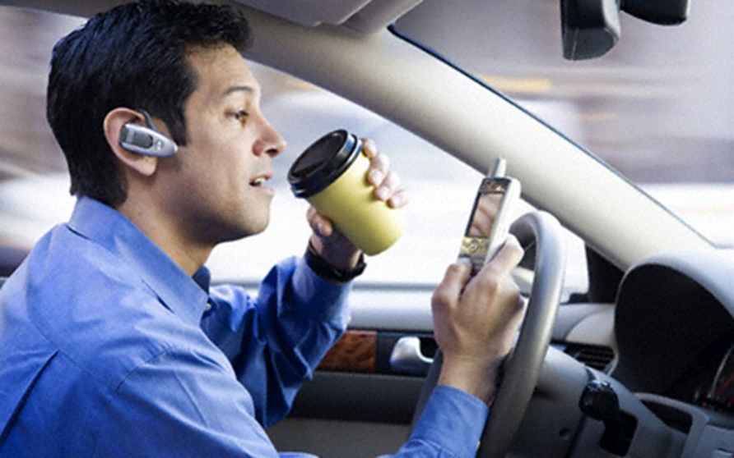
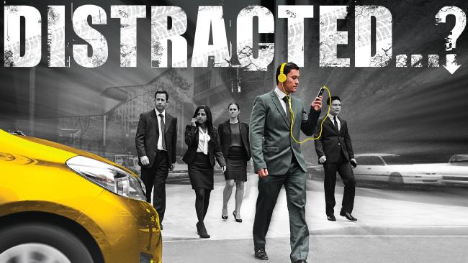
+
=
Double Dip Danger

Slide 3
Your #1 Fleet Safety Goal
for 2020?
Protect
Company
Reduce
Cost
Protect
Employees

Slide 4
Your #1 Fleet Safety Goal
for 2020?
Protect
Employees
Protect
Company
Reduce
Cost

Slide 5
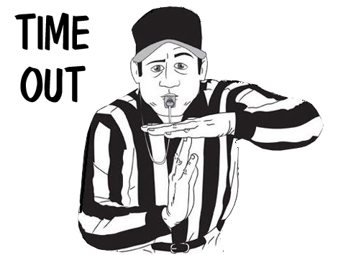
But let’s stop right here!

Slide 6
What’s the #1 take-away you want from this?

Slide 7

Fleet Safety Recommendations
When you give your employees the keys to your vehicles…

Slide 8


Not a time to
PROCRASTINATE.

Slide 9
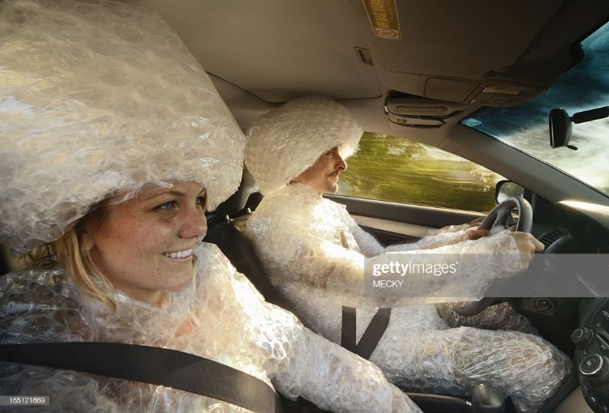
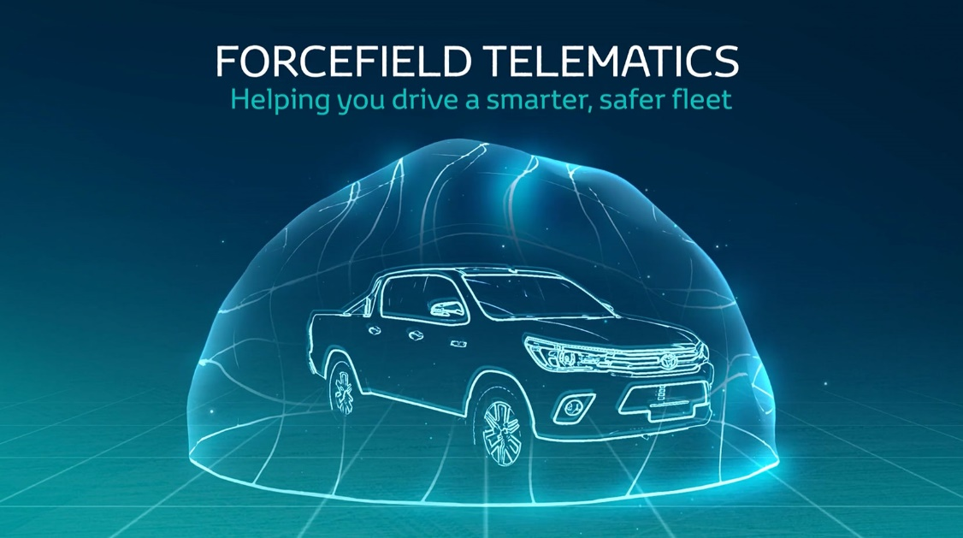
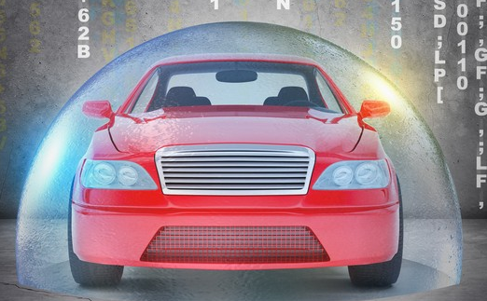
How can we protect Employees?

Slide 10
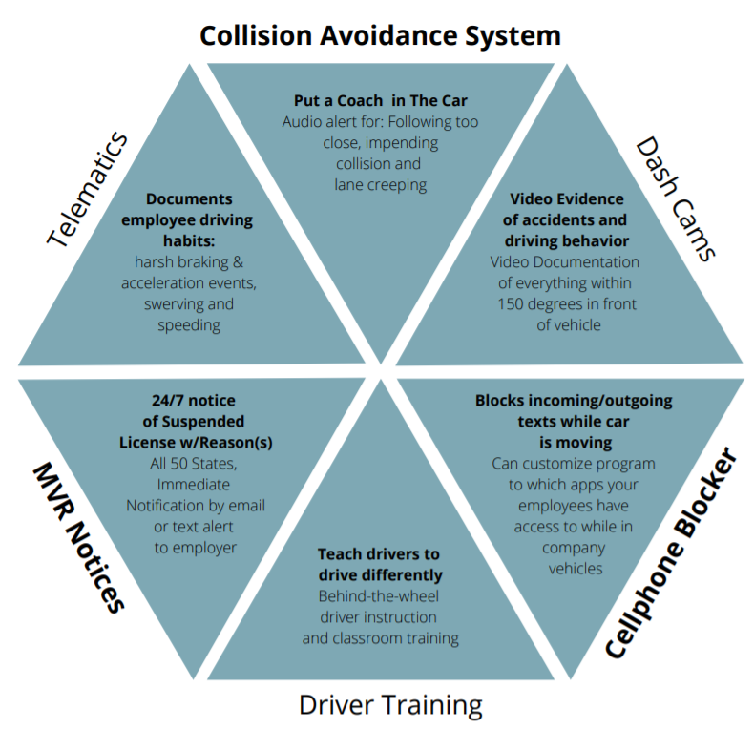

Slide 11
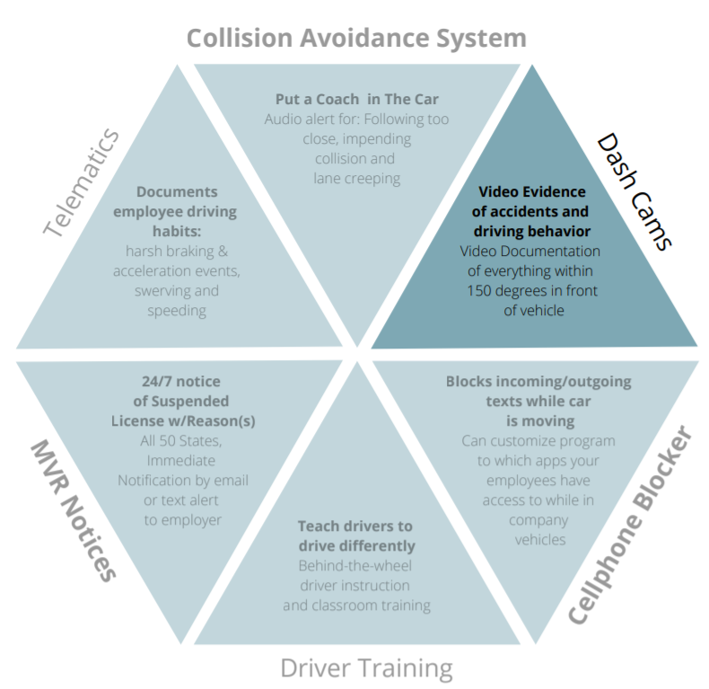
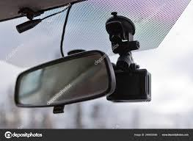

Slide 12
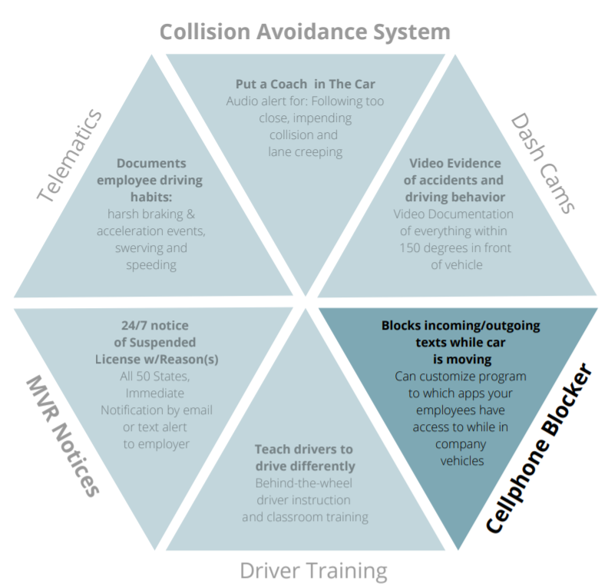
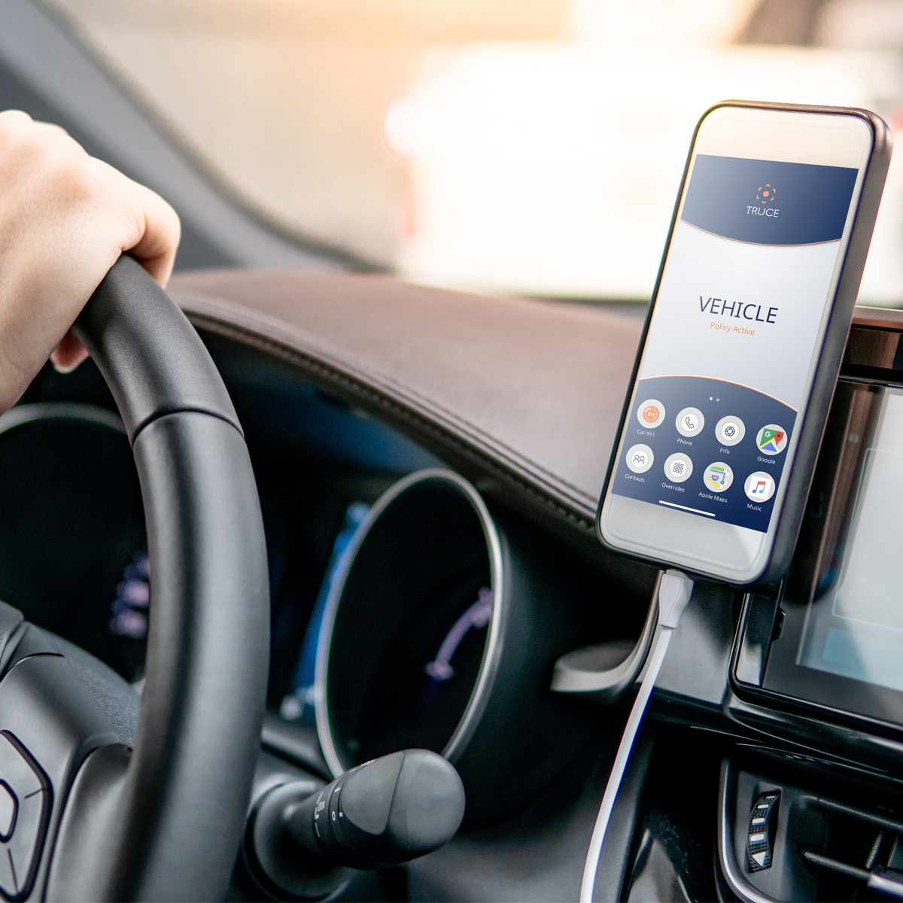

Slide 13
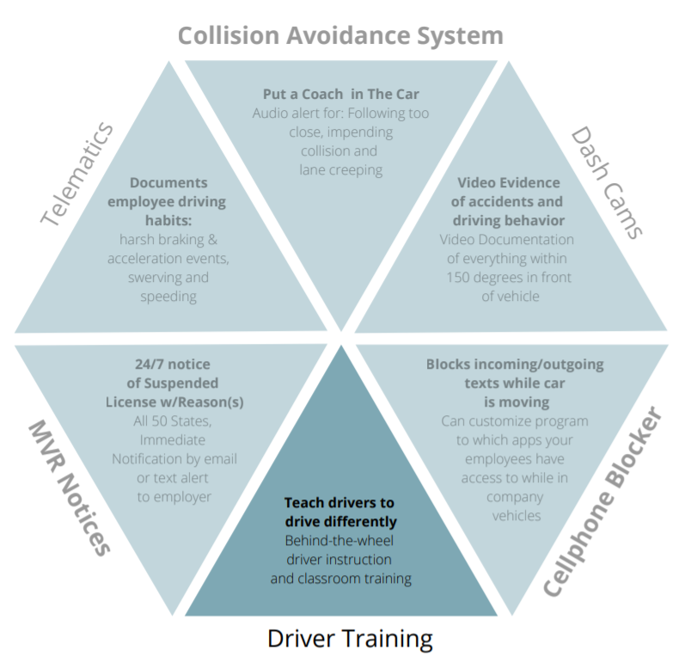


Slide 14
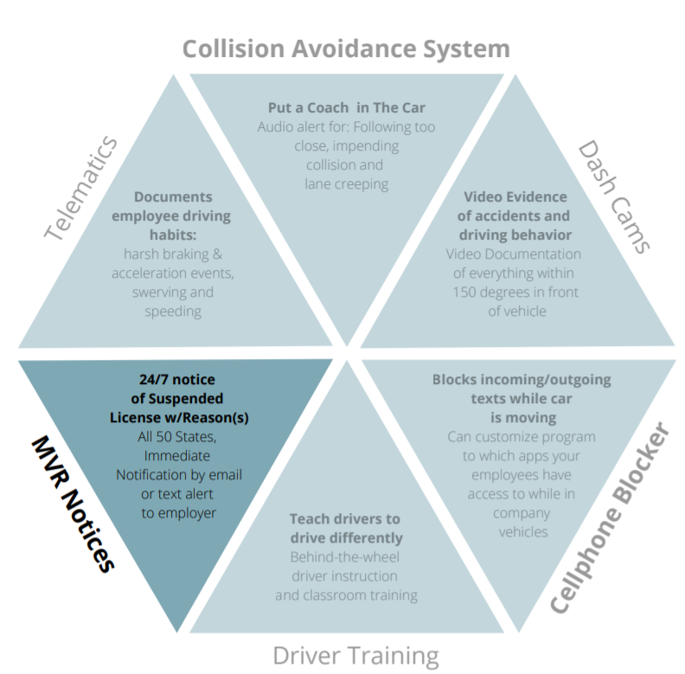


Slide 15
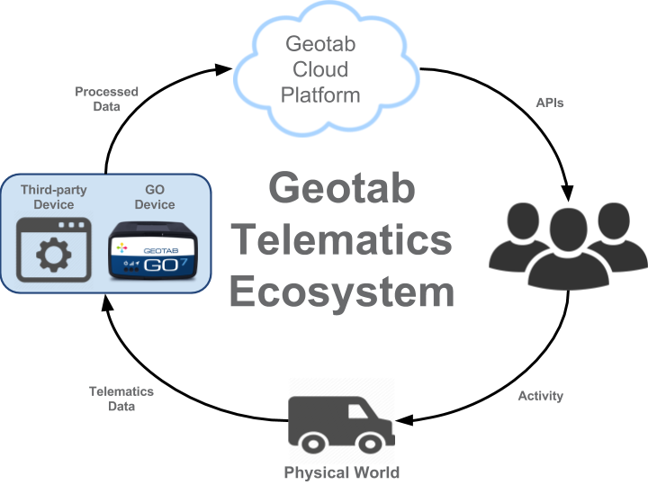
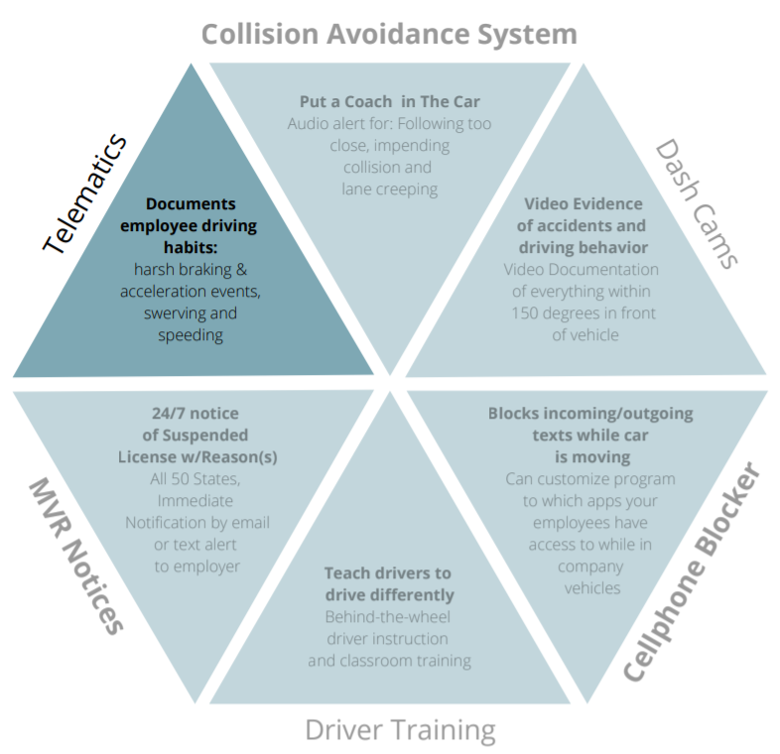

Slide 16
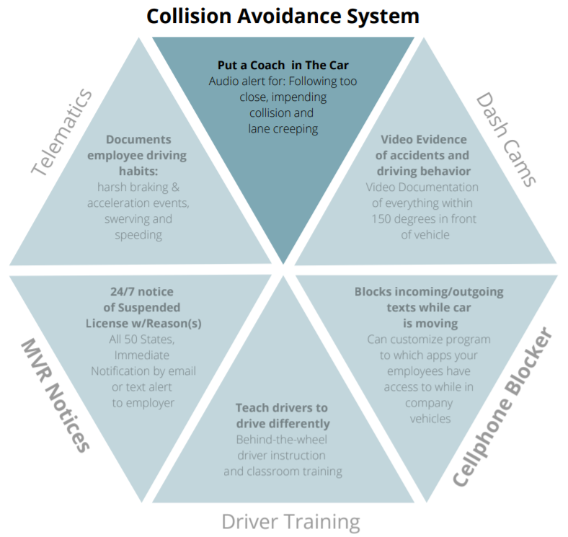
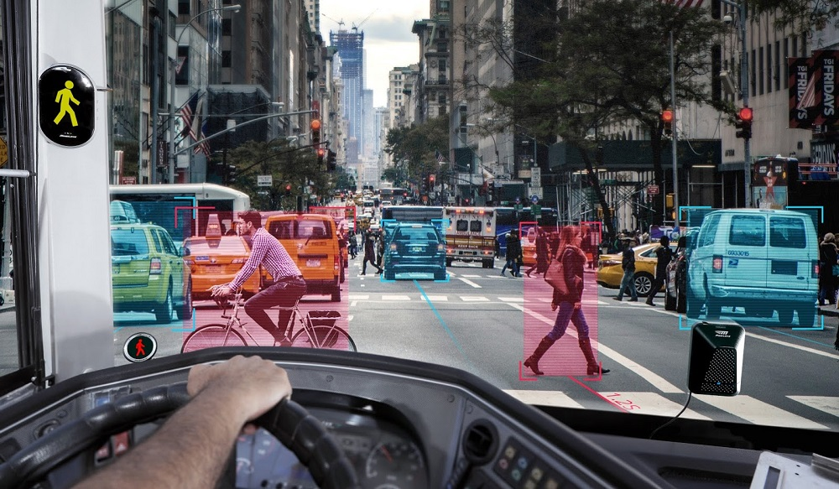

Slide 17
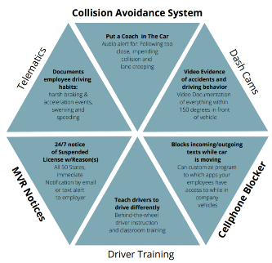

Slide 18
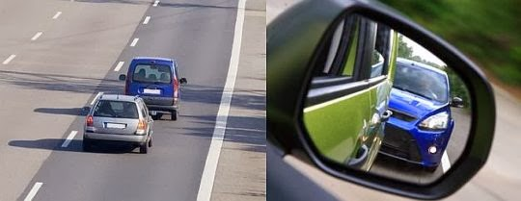
Forward Collision Warning - Ding-Ding-Ding!

Slide 19
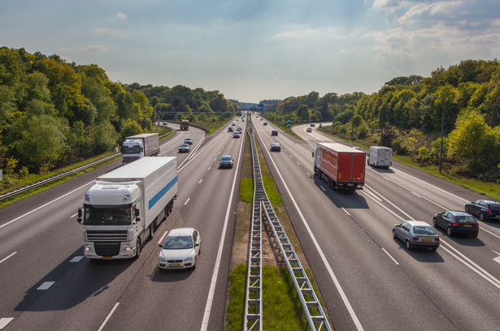
Following too close? Ding!
CAV constantly monitors the distance, in seconds, to the vehicle ahead.
Alert sounds off if distance becomes unsafe.

Slide 20
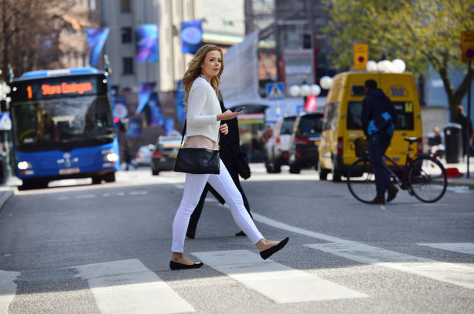
Multiple Dings! Before An Imminent Collision With:
Pedestrian Or Cyclist

Slide 21

Lane Departure Warning: Ding – Ding – Ding!
Stops run-off-road crashes.
Stops veering into other lane without signaling crashes.

Slide 22
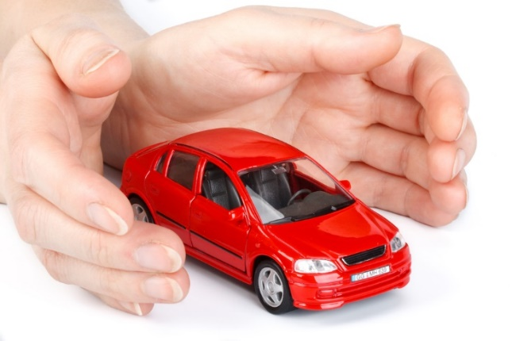
C.A.S. - Collision-Avoidance System
Installation
Warranty
Length of use
Leased Vehicles also?

Slide 23
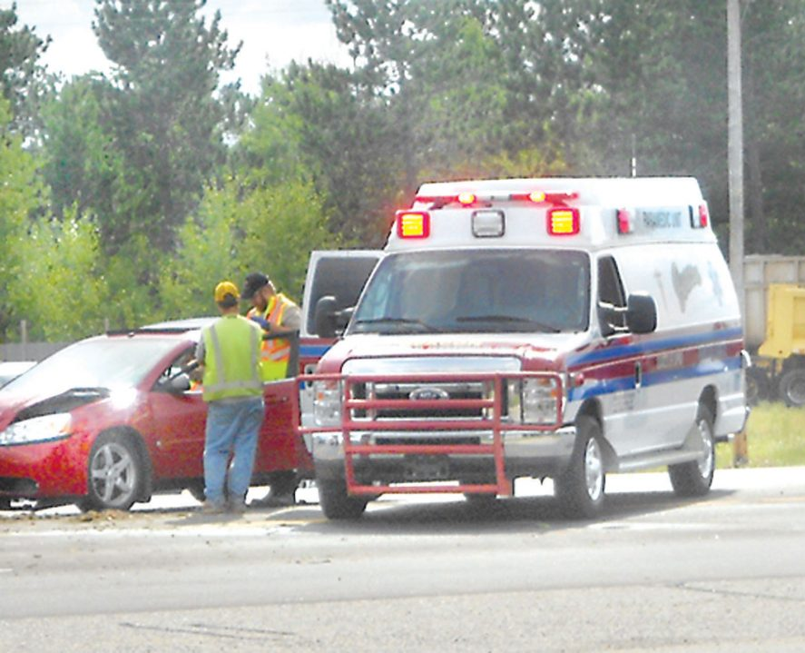
R.O.I. - Collision-Avoidance System “reduce or eliminate”
Major Losses
Employee Injuries
Injuries to Peds/Bicyclists
Large Deductible payments
Future Insurance Cost

Slide 24
What Is An Effective Way To Change Driver Behavior?
Fleet FAQ? Fleet Management & Leasing
A combination of:
Education
Data monitoring
Driver accountability
Is this the answer?
June 14, 2018

Slide 25
Poor driving behavior.
Can it be changed?
YES!

Slide 26
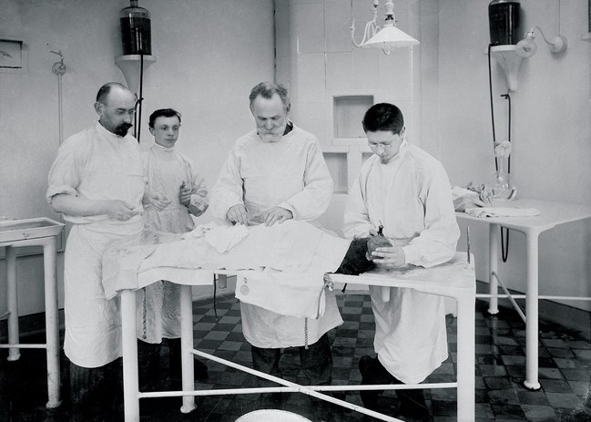
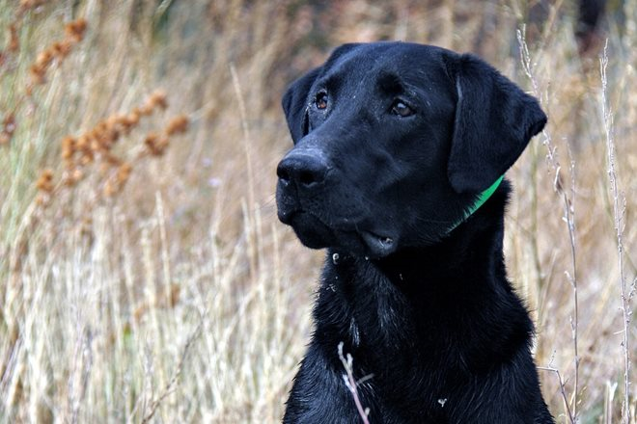
Pavlov’s Dogs
Ivan Pavlov – 1902
Testing Salivation of Dogs when he accidentally discovered:
Conditioned responses
Dogs would ‘salivate’ when they saw the white lab coats coming.
Dogs knew food was on the way.

Slide 27
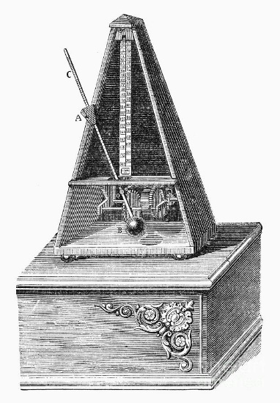
Pavlov’s Dogs – next step
Next :
He used a Metronome.
The sound alerted the Dogs that found was on the way.
This sound caused instant salivation.

Slide 28
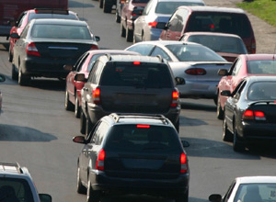
Can Humans Be Conditioned To Drive More Safely?

Slide 29


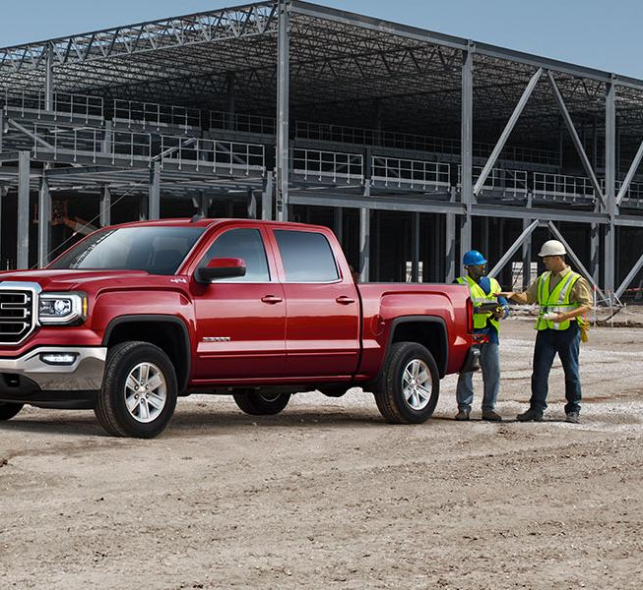
What Will Change Drivers’ Behavior?
ANSWER: Constant reminders every time they drive.
Conditioning with a “Coach in the Car”.

Slide 31
 |  |  | Employer Options for Pick-ups & Autos
 |  | Owned by: |  | Insured by: |  | Use: |  | Paid to Employee:
 | 1 | Company |  | Company |  | 24/7 |  | -
 | 2 | Company |  | Company |  | Work Only |  | -

Slide 32
 |  |  | Employer Options for Pick-ups & Autos
 |  | Owned by: |  | Insured by: |  | Use: |  | Paid to Employee:
 | 1 | Company |  | Company |  | 24/7 |  | -
 | 2 | Company |  | Company |  | Work Only |  | -
 | 3 | Employee |  | Company |  | 24/7 |  | Car Allowance
 | 4 | Employee |  | Employee/Co. |  | 24/7 |  | Car Allowance

Slide 33
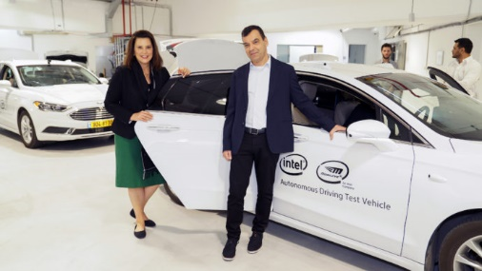
Michigan Governor, Gretchen Whitmer,
Adds Collision Avoidance Tech to State Vehicles.
Nov,2019

Slide 34
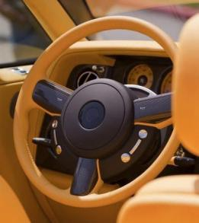
Are car safety features too distracting to drivers?
  Only if they are driving poorly.
Do the safety features outweigh the annoyance?
  Yes.
Will some drivers rely too much on safety features?
  Poor driving will cause audio alerts. They will improve.

Slide 35
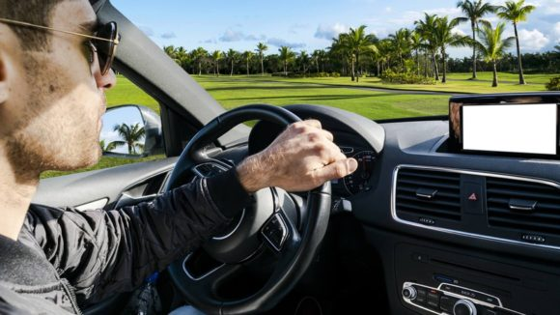
Telematics = Records Driver Behavior
Collision = Changes Driver Behavior
Avoidance
System

Slide 36
How Urgent Is All This?

Slide 37

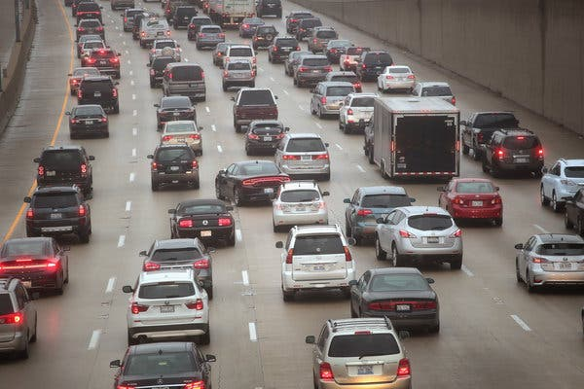
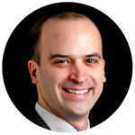
David Leonhardt
America Is Now an Outlier on Driving Deaths
Nov. 19, 2017
USA has:
The most dangerous roads in the industrialized world
A vehicle fatality rate 40% higher than Canada and Australia

Slide 38
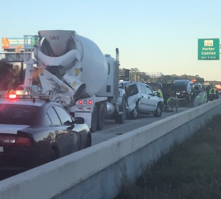
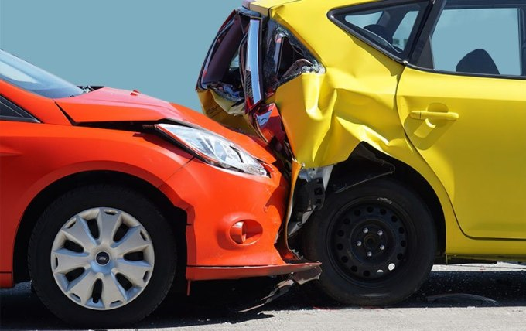
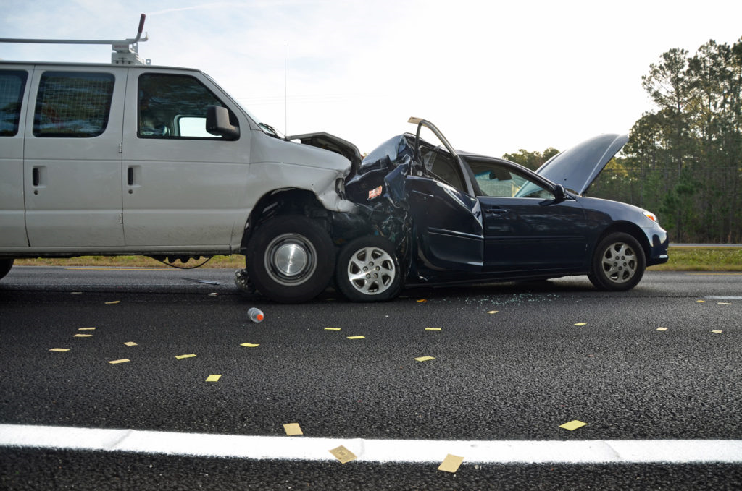
Today: Distracted Driving

Slide 39
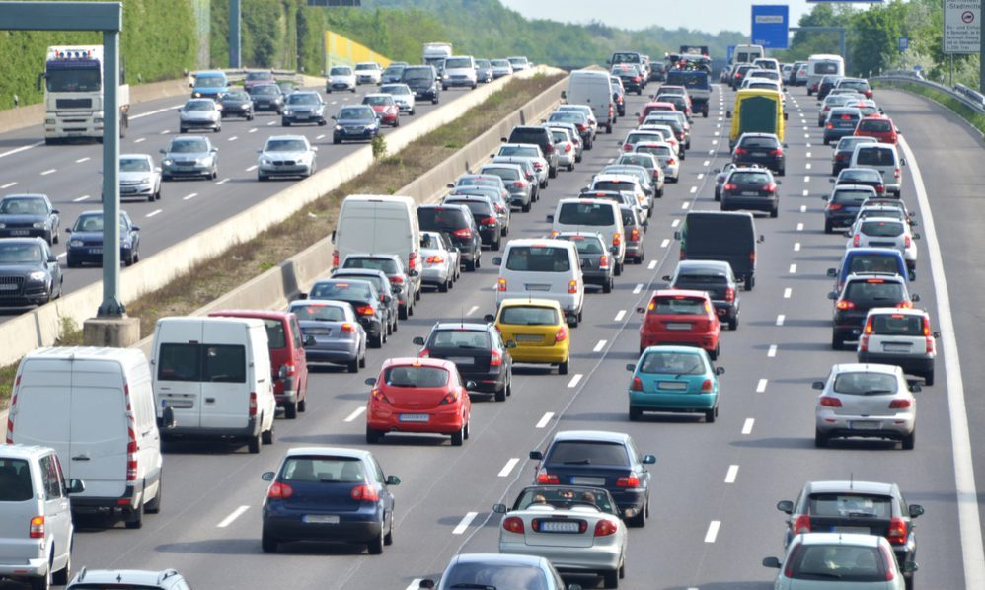
Tomorrow: Driving Behavior Changes = Few Accidents

Slide 40

Protecting Your Employees

Slide 41
We Can Make a Difference

Slide 42
Thank You
Jim_Berriatua@AJG.com 415-254-0606

Slide 43
 | Fleet Safety Scorecard
 | (Points) | (Yes/No) | (Risk Management Action)
 | 20 | [ ] | Car Allowance vs. Co. Owned Vehicles
 | 20 | [ ] | Written Policy
 |  |  | Who can drive, when, where, Discipline
 | 20 | [ ] | 24/7 MVR Checks
 | 20 | [ ] | Dash Cams Front - 180 *
 | 20 | [ ] | Telematics w/Policy and Managed well
 | 10 | [ ] | No Cell Phone while driving policy
 | 10 | [ ] | Driver Education
 | 50 | [ ] | Collision-Avoidance System:
 |  |  |  | Safe following warnings
 |  |  |  | Lane Departure warnings
 | _____ | [ ] | Other? ______________________
 | ________ |  | Total Points

Slide 44
Interesting Facts about
Auto Safety

Slide 45
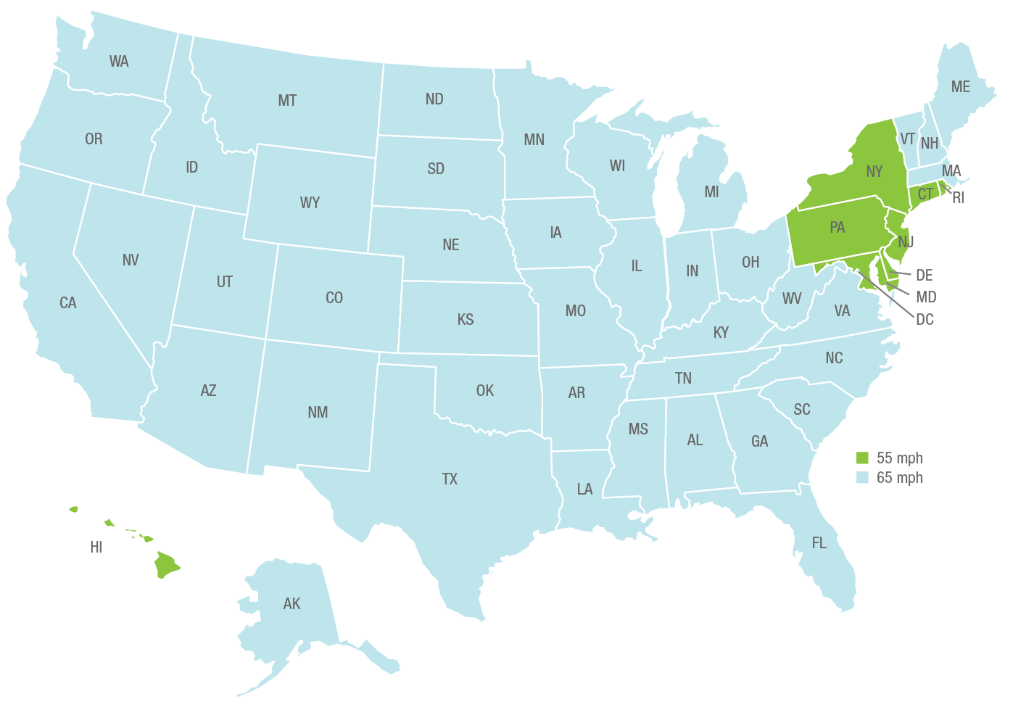
1993 Max. speed limits
65 mph

Slide 46
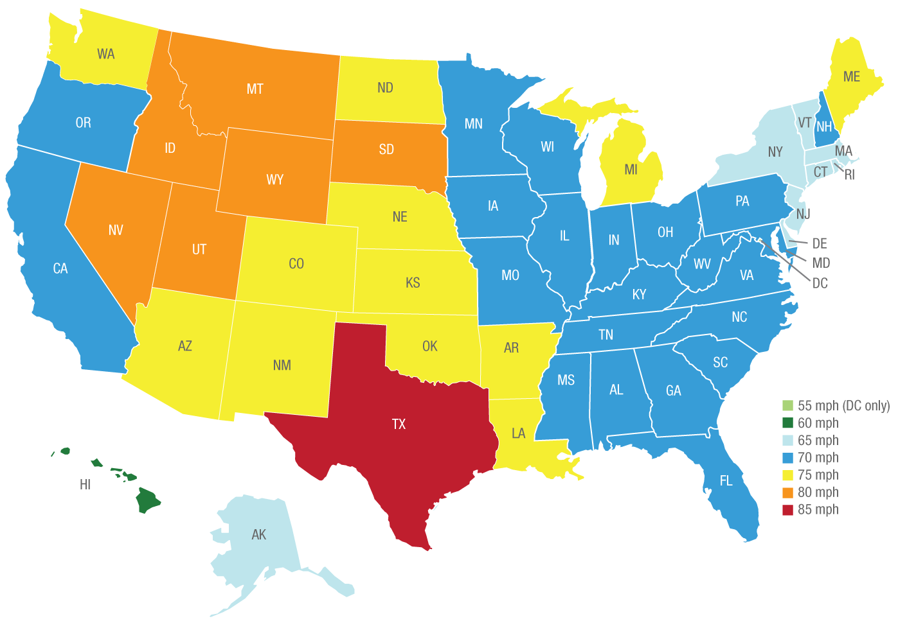
Max. speed limits today + Distracted Drivers?
80 mph
75 mph
70 mph
85 mph

Slide 47
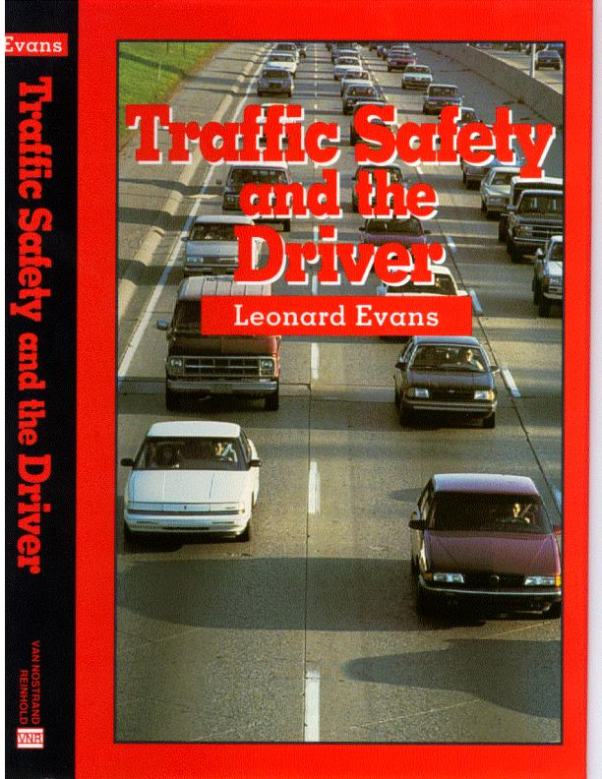
“Small increases in
speed limits
lead to
large changes
in HARM.”

Slide 48
Cell phone use “while driving a vehicle”
Hand-Held vs. Hands-Free

Slide 49
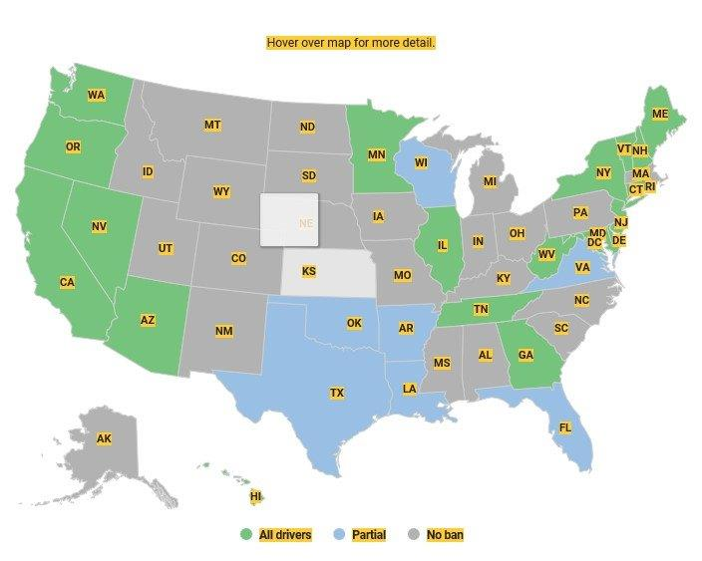
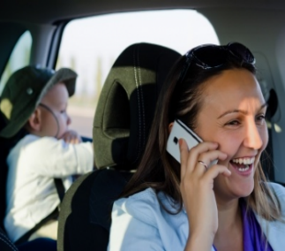
Handheld cell phone use banned in 20 states

Slide 50
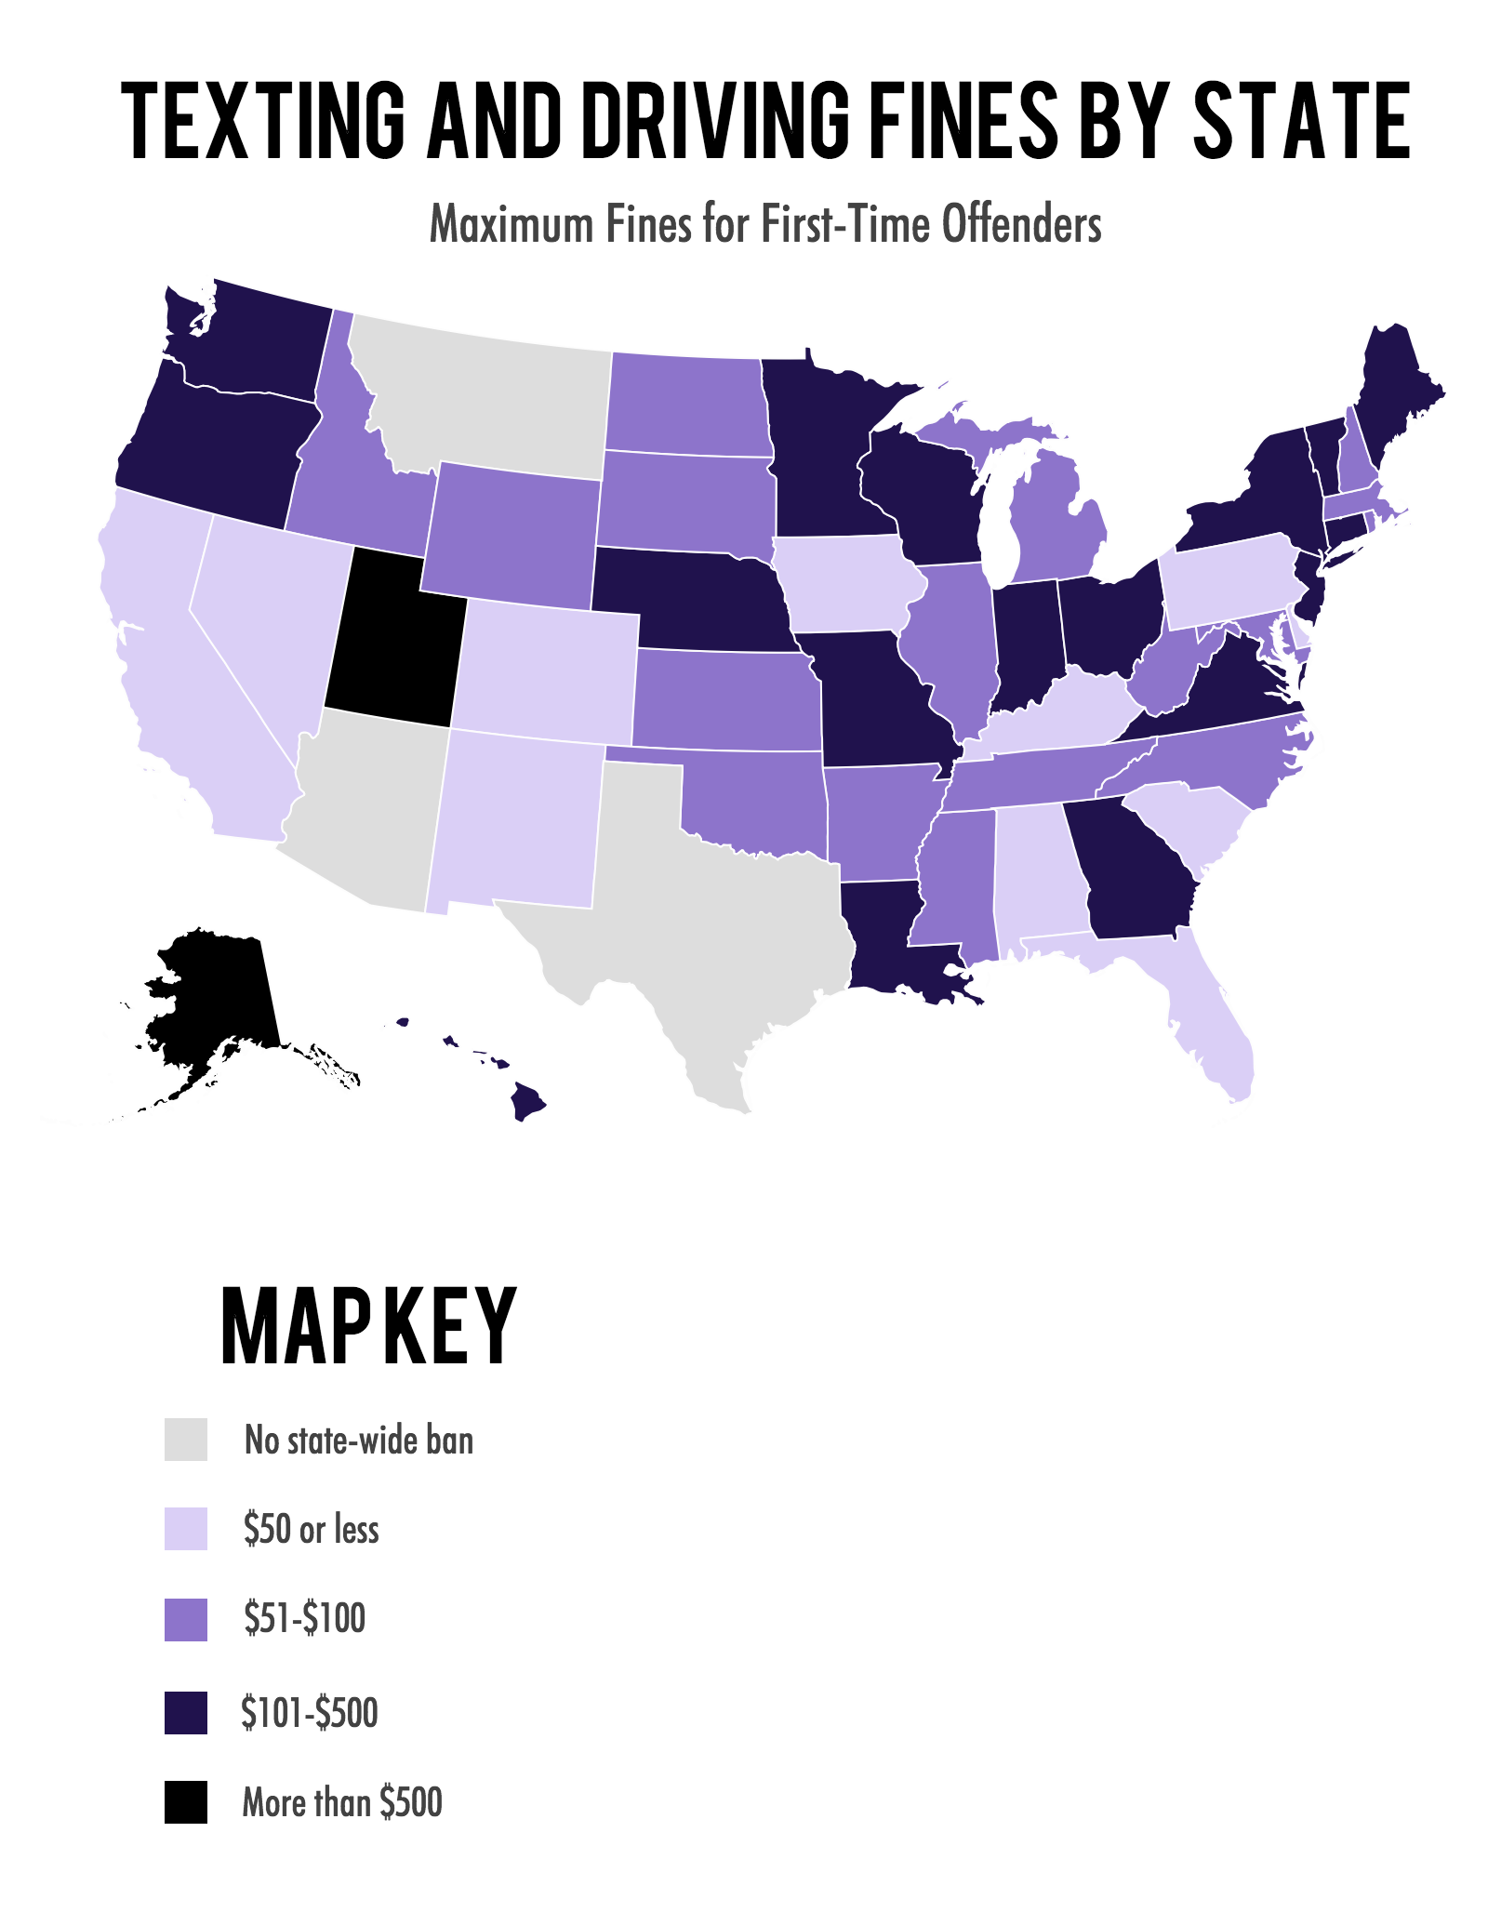
Texting and driving fines by state
Maximum fines for first-time offenders
Info from: Krista Doyle – Aceable Co.

Slide 51
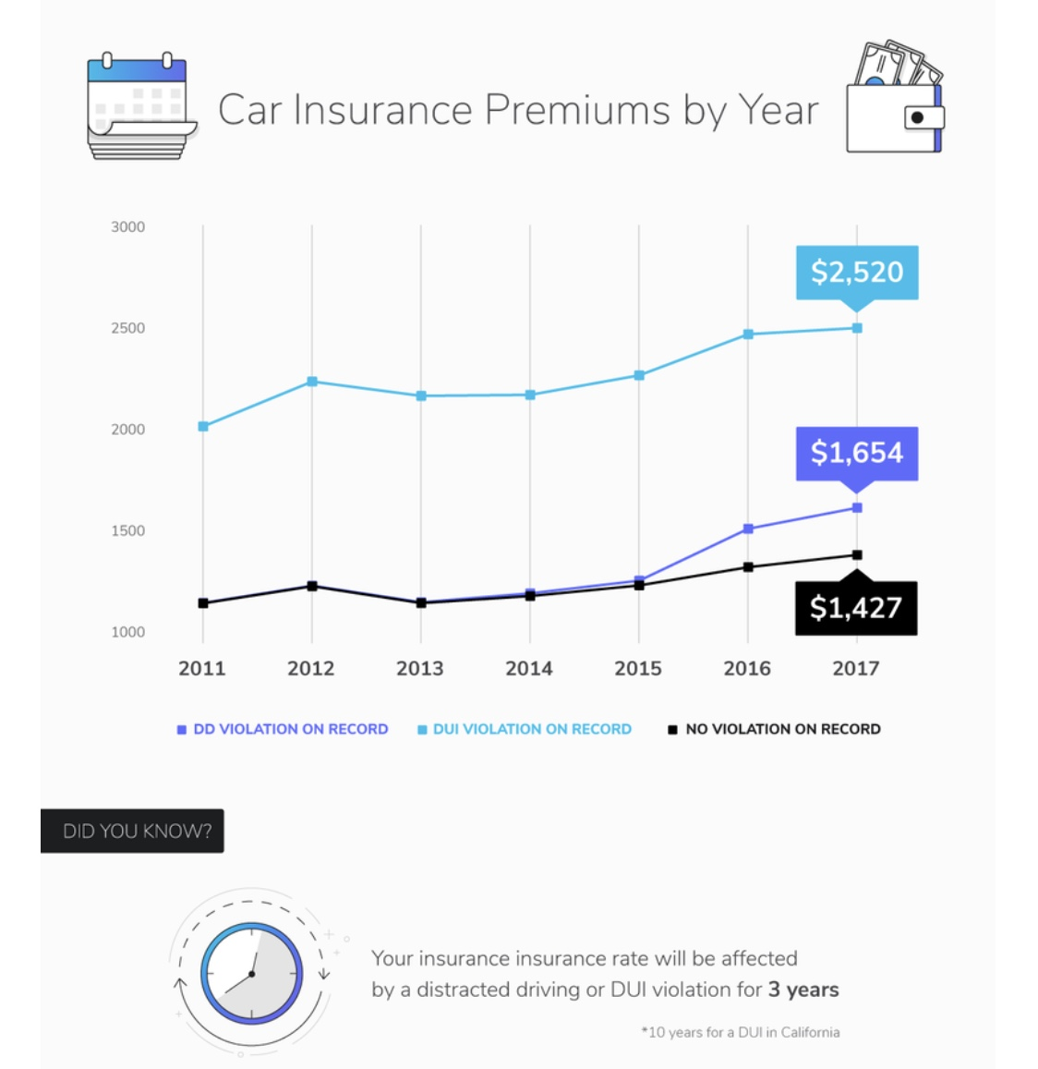

Slide 52
w/DUI
w/D.D.
+$227/yr.

Slide 53
USA auto safety
Canada, Australia, UK, Europe auto safety

Slide 54
USA auto safety
Canada, Australia, UK, Europe auto safety
DUI = .08 DUI = .05 (.00 for Bus/Taxi Drivers)

Slide 55
USA auto safety
Canada, Australia, UK, Europe auto safety
DUI = .08 DUI = .05 (.00 for Bus/Taxi Drivers)
Seat belts in rear seats of vehicles
“Not Required” “Required”

Slide 56
USA auto safety
Canada, Australia, UK, Europe auto safety
DUI = .08 DUI = .05 (.00 for Bus/Taxi Drivers)
Seat belts in rear seats of vehicles
“Not Required” “Required”
Canada uses speed cams

Slide 57
USA auto safety
Canada, Australia, UK, Europe auto safety
DUI = .08 DUI = .05 (.00 for Bus/Taxi Drivers)
Seat belts in rear seats of vehicles
“Not Required” “Required”
Canada uses speed cams
Black box used frequently by insurers (UK/Europe)

