Slide 1

Claims: preservation, preparation, AND presentation
Michael Metz-Topodas
September 10, 2019

Slide 2
INTRODUCTION
  Cohen Seglias, is one of the largest construction litigation firms on the East Coast.
  We represent over 1,000 construction and construction-related companies in over 30 states.
  We help them with claims, labor issues, business transactions and compliance, and much more.
  We have 9 offices and more than 65 lawyers.

Slide 3

Timing is everything
  Timely assertions of, or responses to, claims are essential to a successful project
  Claims are going to happen.
  If untimely asserted or addressed, potential exposure goes up.
  If untimely asserted or addressed, the claim could be released or waived.

Slide 4

What is a Claim?
Requests for adjustment to the terms of your subcontract
  usually seeking additional time and/or money
Look to your subcontract
  no standard, recognized definition

Slide 5
What is a Claim?
AIA A201-2007 §15.1.1 “Definition”
A claim is a demand or assertion by one of the parties seeking, as a matter of right, an adjustment or interpretation of Contract terms, payment of money, extension of time or other relief with respect to the terms of the Contract.

Slide 6
The 3 Ps
Preservation
Notice, Notice, Notice: follow the written notice requirements of your subcontract!
Partial Releases: think carefully about what change orders, time extension requests, and other claims are unresolved with each monthly payment application .
Record Keeping: your claim is only as good as contemporaneous records you keep.
  (e.g., cost records, daily reports, progress reports, photos etc.)

Slide 7
The 3 Ps
Preparation
After you’ve given notice, track your costs along the way.
Keep the costs separate with “x” numbers, cost codes, etc.
As numbers and details crystallize, consider supplementing notice with a more detailed letter (including documentation)—your subcontract may even require it!
At a minimum, follow up in writing well in advance of closeout.
Consider consulting with a lawyer and/or expert along the way (behind the scenes).

Slide 8
The 3 Ps
Presentation
Set up meetings when possible—your subcontract may even require it!
Pictures and graphics are worth 1,000 words.
If you are a subcontractor, allow for the possibility that the GC can prove that the owner caused some or all of the impacts (opens door for teaming up).
Bring a diverse team (e.g., officer with authority, project manager, and superintendent).
Consider engaging a lawyer and/or expert to help to refine and present your claim.

Slide 9
When can one make a claim?
Look to the Agreement:
  Example, AIA A201-2007, 15.1.2:
  “Claims by either party must be initiated within 21 days after occurrence of the event giving rise to such Claim or within 21 days after the claimant first recognizes the condition giving rise to the Claim, whichever is later.”
Can failure to follow this provision result in a waiver?
  Actual Notice
  Prejudice

Slide 10

How does one make a claim?
Look to the Agreement:
  Example, AIA A201-2007, 15.1.2:
  “Claims by either the Owner or Contractor must be initiated by written notice to the other party and to the Initial Decision Maker with a copy sent to the Architect, if the Architect is not serving as the Initial Decision Maker.”

Slide 11

What type of claims can be asserted?
Up-the-Chain Claims:
Payment
  failure to pay, wrongful withholding, retainage

Slide 12
Types of Claims

Slide 13
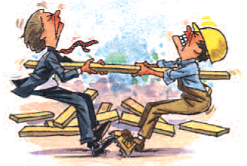
Up-the-Chain Claims
Added Scope

Slide 14

Up-the-Chain Claims
Delay
What is delay?
An event that causes increased time of performance and consequently causes subcontract completion to occur later than planned.

Slide 15

Up-the-Chain Claims
Acceleration
What is acceleration?
A compression of time to perform work

Slide 16
Down-the-Chain Claims
Deficiencies in workmanship
Failure to perform
Delay damages (often via liquidated damages)
Indemnity
  Loss (fire, theft, damage, violation)
  Liable up-the-chain (delays, breach, etc.)

Slide 17
Best Practices for Preserving a Claim
Identify the event or cause of your damages
Prepare written notice
Identify and capture your damages with documents
  Extra Work
  Delay/Acceleration
  Non-payment, wrongful withholding, untimely payment
Do everything you can not to inadvertently waive claims!

Slide 18

Best Practices for Preserving a Claim
Consider future exposure to damages
  Cumulative Impact
  Liquidated Damages
  Indemnity

Slide 19
Preserving Claims:
PARTIAL/FINAL RELEASES
Read them carefully and keep your accounting department in the loop of claims.
Acceptance of final payment can serve as a release of claims.
Imperative that you qualify the release, even if being submitted electronically.
Watch out for language on the pay app itself.
Be careful for language on Change Orders that limits/waives your right to pursue claims.

Slide 20
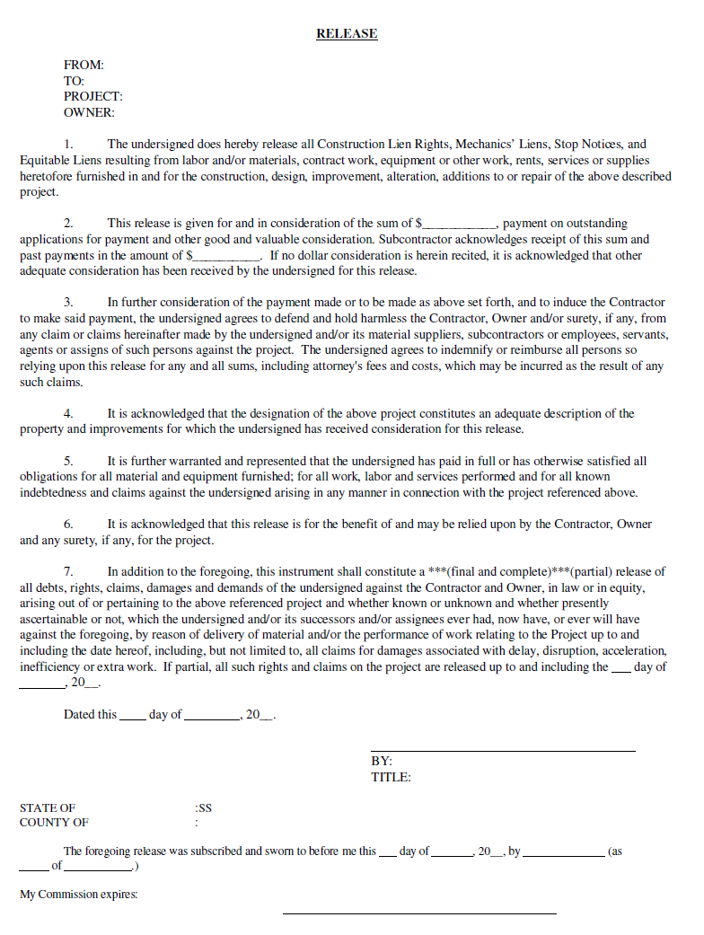
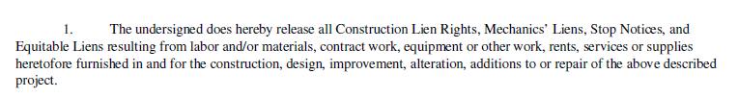
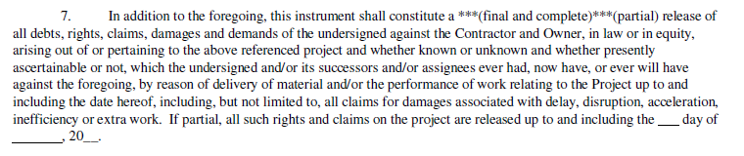
THE DREADED MONTHLY RELEASE

Slide 21
THE DREADED MONTHLY RELEASE
Include a statement on the Partial Waiver/Release form that states the Subcontractor does not waive, and specifically reserves, all claims for additional compensation and additional time for work performed for [insert the description here].
Include as much detail that would be necessary for a third party to understand that you are reserving your rights for money and time with respect to specific work.
What if the Owner/GC rejects your additional language?

Slide 22
THE DREADED MONTHLY RELEASE
Best Practice:
If you need to be paid, then you should sign the Waiver without the additional statement, but you must transmit it with a contemporaneous letter that states the Owner/GC rejected your change, but that you need to be paid, so you have signed the Waiver but you reserve all of your rights.
In the letter, you should identify all of the Claims for which you are reserving your rights.
The law is not clear whether this procedure will protect your rights to payment. So, you should consult with your attorney.

Slide 23

CLAIMS FOR nonPAYMENT
Payment (periodic, final, retainage)
  When are you entitled to payment?
    Pay-when-Paid
    Pay-if-Paid

Slide 24

CLAIMS FOR nonpayment
  Have you satisfied all conditions precedent to the payment?
  Submission of pay application
  Submission of all required pay app attachments (waivers, etc.)
  Have requisitioned change orders been approved?

Slide 25

Withholding PAYMENT
Can your payment be withheld?
Perhaps.
  Is there a contractual basis to withhold (deficiency work, breach)?
  How much payment can be withheld?
    Per Contract
    Per Payment Act
  Preconditions to withholding payment

Slide 26
Suspending Work for
Non-Payment
  Is there an express contractual right? Not usually.
  Example, AIA A201-2007, 15.1.3:
  “CONTINUING CONTRACT PERFORMANCE Pending final resolution of a Claim, except as otherwise agreed in writing or as provided in Section 9.7 and Article 14, the Contractor shall proceed diligently with performance of the Contract and the Owner shall continue to make payments in accordance with the Contract Documents.”
  Be careful with suspending work – unless there is a clear justification and right to do so, the suspension itself may be a material breach of the subcontract.

Slide 27
Suspending Work Statutory rights
  Statutes in Pennsylvania and New Jersey allow subcontractors to suspend work if they are not being paid, regardless of what your subcontract says
  Example: NJ Prompt Payment Statute, NJSA 2A:30-A-2(d):
    “A [Contractor] may, after providing seven calendar days’ written notice to the party failing to make the required payments, suspend performance of construction contract, without penalty for breach of contract, until the payment required pursuant to this section is made, if the [Contractor]: is not paid as required by this section; is not provided a written statement of the amount withheld and the reason for the withholding; and the payor is engaged in a good faith effort to resolve the reason for the withholding”

Slide 28

Suspending Work Statutory rights
  Pennsylvania’s Contractor and Subcontractor Payment Act was recently amended to give subcontractors the right to suspend work without penalty after multiple written notices.

Slide 29

Suspending Work for Non-Payment
  What are the practical consequences of suspending/ terminating?
Stop payment
Breach of contract (if not justified)
Could ultimately be held responsible for replacement subcontractor costs

Slide 30
claims for changes to the work
COR: Change Order Request
Best Practice:
  Notify the Owner/GC in writing of the changed condition.
  Send a Change Order Request.
  Wait for a signed Change Order.
Most subcontracts expressly state that Subcontractor is not entitled to compensation for changed conditions without executed change order.

Slide 31

Claims for changes to the work
Disputes over additional work; what should you do?
Determination of cost of additional work – by agreement or pre-determined mark-ups?
  Overhead and Profit
  Supervision
Should you ask for time? [A.A.F.T.]
Cumulative impact claims

Slide 32
Change orders
Before signing change order, you should ask the following questions:
Does Change Order cover all costs to perform extra work?
Does Change Order provide an extension of time to perform extra work?
Does Change Order account for any delay, impact or extended general condition costs?

Slide 33

Claims for changes to the work
What if the Owner/GC requires the Subcontractor to immediately begin the changed work, but a Change Order cannot be issued before the work begins?
Are you obligated to proceed?
Should you proceed with the changed work?

Slide 34
Claims for changes to the work
Best Practice:
Demand that the Owner/GC provide you with a written directive to proceed with the work under agreed-upon terms (check subcontract!).
If Owner/GC does not, then you should send written communication confirming agreed-upon terms.
Submit a Change Order Request that reflects the agreed-upon terms.

Slide 35
Claims for changes to the work
The Owner/GC must sign T&M Tickets.
Sometimes the Owner/GC will “stamp” the T&M Ticket with a statement that says something like they are only signing to verify that the work was performed and the materials were supplied, but they are not signing to approve payment.
Do you care?

Slide 36
Claims for changes to the work
No
This is an acceptable practice, as long as they sign the T&M Ticket.
Why? When the Owner/GC signs the T&M Ticket, it cannot later dispute the accuracy of the time spent and materials that were utilized.

Slide 37

Claims for changes to the work
What if the Owner/GC refuses to sign the T&M Ticket?

Slide 38

Claims for changes to the work
Ask why, and try to resolve the issue. It may be a simple dispute over a quantity of materials, or labor hours.
If it cannot be resolved, then make a note on the T&M Ticket that they refused to sign.

Slide 39

Claims for changes to the work
Once the daily T&M Ticket has been signed (or not), what do you do next?

Slide 40
Claims for changes to the work
Send the tickets to your home office, where they will be compiled, and the time and expenses will be accounted for in your Cost Reports and Schedules.
On a daily basis (or, at a minimum, weekly), the home office should send the tickets to the Owner/GC with an accompanying letter.
This way, the Owner/GC is kept apprised of the progress and has an opportunity to dispute the T&M Tickets.
If the Owner/GC does not dispute the T&M Tickets, they “own” them.

Slide 41

What about a Rejected Change?

Slide 42
How to handle rejected change orders
Subcontractor
  believes that a specific condition was not included in the Subcontract Documents;
  concludes change requires Subcontractor to perform extra work;
  contends it is entitled to a change in the Subcontract Price and Subcontract Time.

Slide 43
How to handle rejected change orders
Owner/GC
  believes the specific condition was included in the Subcontract Documents;
  so it demands the Subcontractor perform the in-scope work;
  will not agree to changes to the Subcontract Price or the Subcontract Time.

Slide 44

How to handle rejected change orders
What do you do in this situation?

Slide 45

How to handle rejected change orders
Send a letter to the Owner/GC.
State that the Owner/GC directed you to perform the work, even though the work is not included in your Subcontract.
State that you will perform the work under protest, and that you will file a Claim.

Slide 46

How to handle rejected change orders
Unfortunately, in this situation, there is not much the Subcontractor can do except initiate a Claim under the “Disputes” or “Claims” provisions of the Subcontract.
Your subcontract likely requires you to perform despite scope disagreement.

Slide 47

How to handle rejected change orders
Review your Subcontract to ensure you provide timely notice of your Claim and fulfill all conditions precedent to filing the Claim.
Strictly follow the Claims procedure outlined in your Subcontract.

Slide 48

How to handle rejected change orders
While you are in the claims process,
  Are you required to perform the extra work?

Slide 49

How to handle rejected change orders
Most Subcontracts contain a provision that requires Subcontractors to continue the work while Claims are being decided.
Review your Subcontract and the Contract Documents for this important language.

Slide 50
How to handle rejected change orders
Best Practice:
The preferred course of action is to perform the work (if financially feasible), and maintain complete and accurate records of the costs and time to perform the extra work.
Why?

Slide 51
How to handle rejected change orders
If you refuse to perform the extra work, the Owner/GC will engage another Subcontractor to perform it (probably at a higher cost).
The Owner/GC may commence a lawsuit (or arbitration) against you for Breach of Contract to recover the additional costs, which may include delay costs associated with the time to engage another Subcontractor.

Slide 52

How to handle rejected change orders
While performing the extra work, carefully track all your costs and time.
These will be important backup in proving your Claim.
  T&M Tickets
  Job Costing
DO NOT SIGN RELEASES!!!!

Slide 53
Claims related to project delays
Types of Delays:
Non-excusable Delay – fault lies with you, and no compensation will follow.
Excusable but Non-compensable Delay – no one is at fault. You get more time, but no money.
Excusable and Compensable Delay – fault lies with the other party. You get time and money (if you can prove it).

Slide 54
Project Delay: Typical Causes
Failure to provide access (or limited access only)
Unforeseen subsurface conditions
Impossible to perform work
Design changes
Failure to have shop drawings and samples prepared and approved in a timely manner
Failure to have materials and equipment delivered in a timely manner
Delayed by another Subcontractor

Slide 55
Project Delay: Typical Causes
Delayed permitting
Weather events
Strikes and labor disputes
Low productivity
Cash flow restrictions
Lack of project coordination
Labor mobilization

Slide 56
Notice of delay/time extensions
MUST consult the subcontract
  What does it require?
Questions for the end of each month:
  Are we following the original schedule?
    If not, why not?
  What should we do about it?
    Take appropriate action!

Slide 57

Costs associated with delay
What are recoverable delay damages?
  Extended job supervision & field overhead costs
  Extended equipment costs
  Wage/material escalation
  Inefficiency
  Finance costs
  Reduced job opportunities and bond capacity
  Lost profits
  Unabsorbed home office overhead

Slide 58
Delay claims – Best Practices
Written notice to Owner (and/or GC, if applicable) of delay ASAP.
Identify specific areas of work impacted by delay.
Identify the manner in which you are being damaged.
An example written notice…

Slide 59
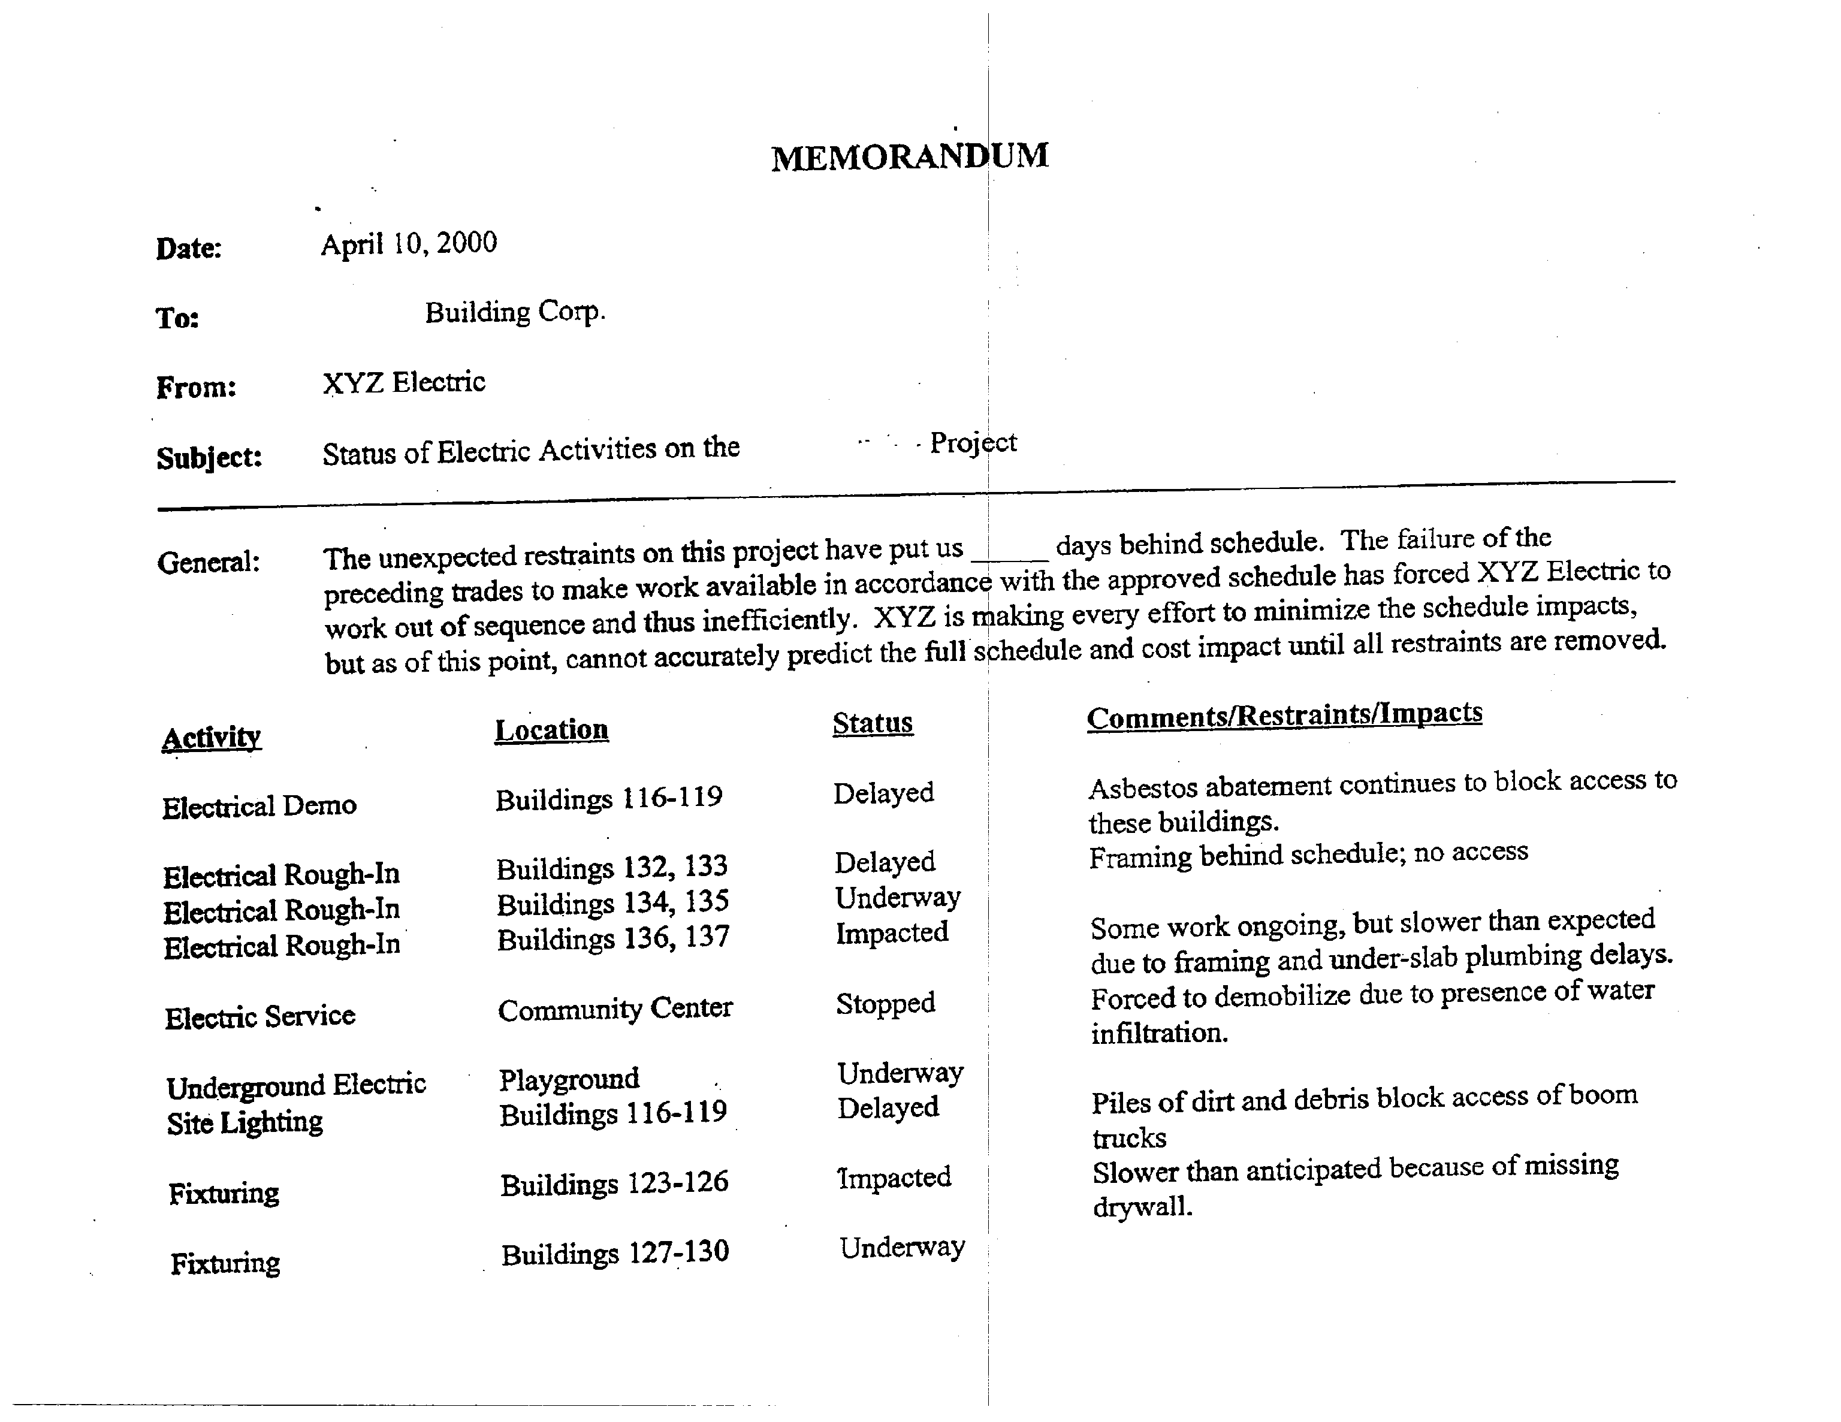

Slide 60
Causes of Acceleration
Decision by Contractor
Directive by Owner or architect/engineer (A/E) to finish entire project early
Directive by Owner or A/E to finish part of project early
Delay or stop by Owner with no extension
Failure by Owner or A/E to grant valid time extension
Directive by Owner to man project at certain levels

Slide 61

Costs of acceleration
What are acceleration/compression damages?
Overtime/Increased Labor Hours
Inefficiencies of overall operations
Costs of expedited vendor delivery
Additional supervision and overhead
Reduction of equipment rental costs

Slide 62
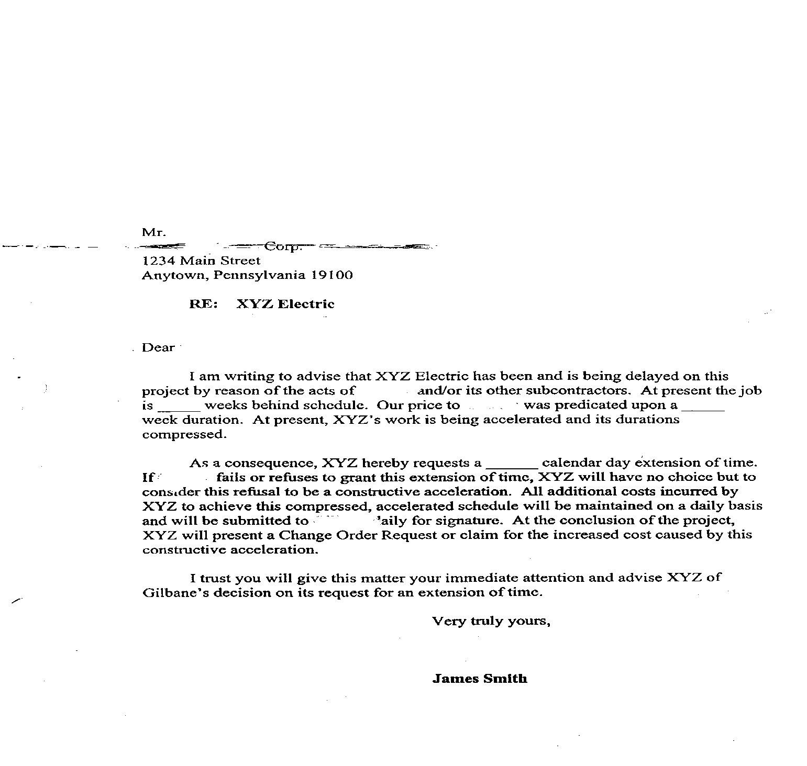
Preserving acceleration claims

Slide 63
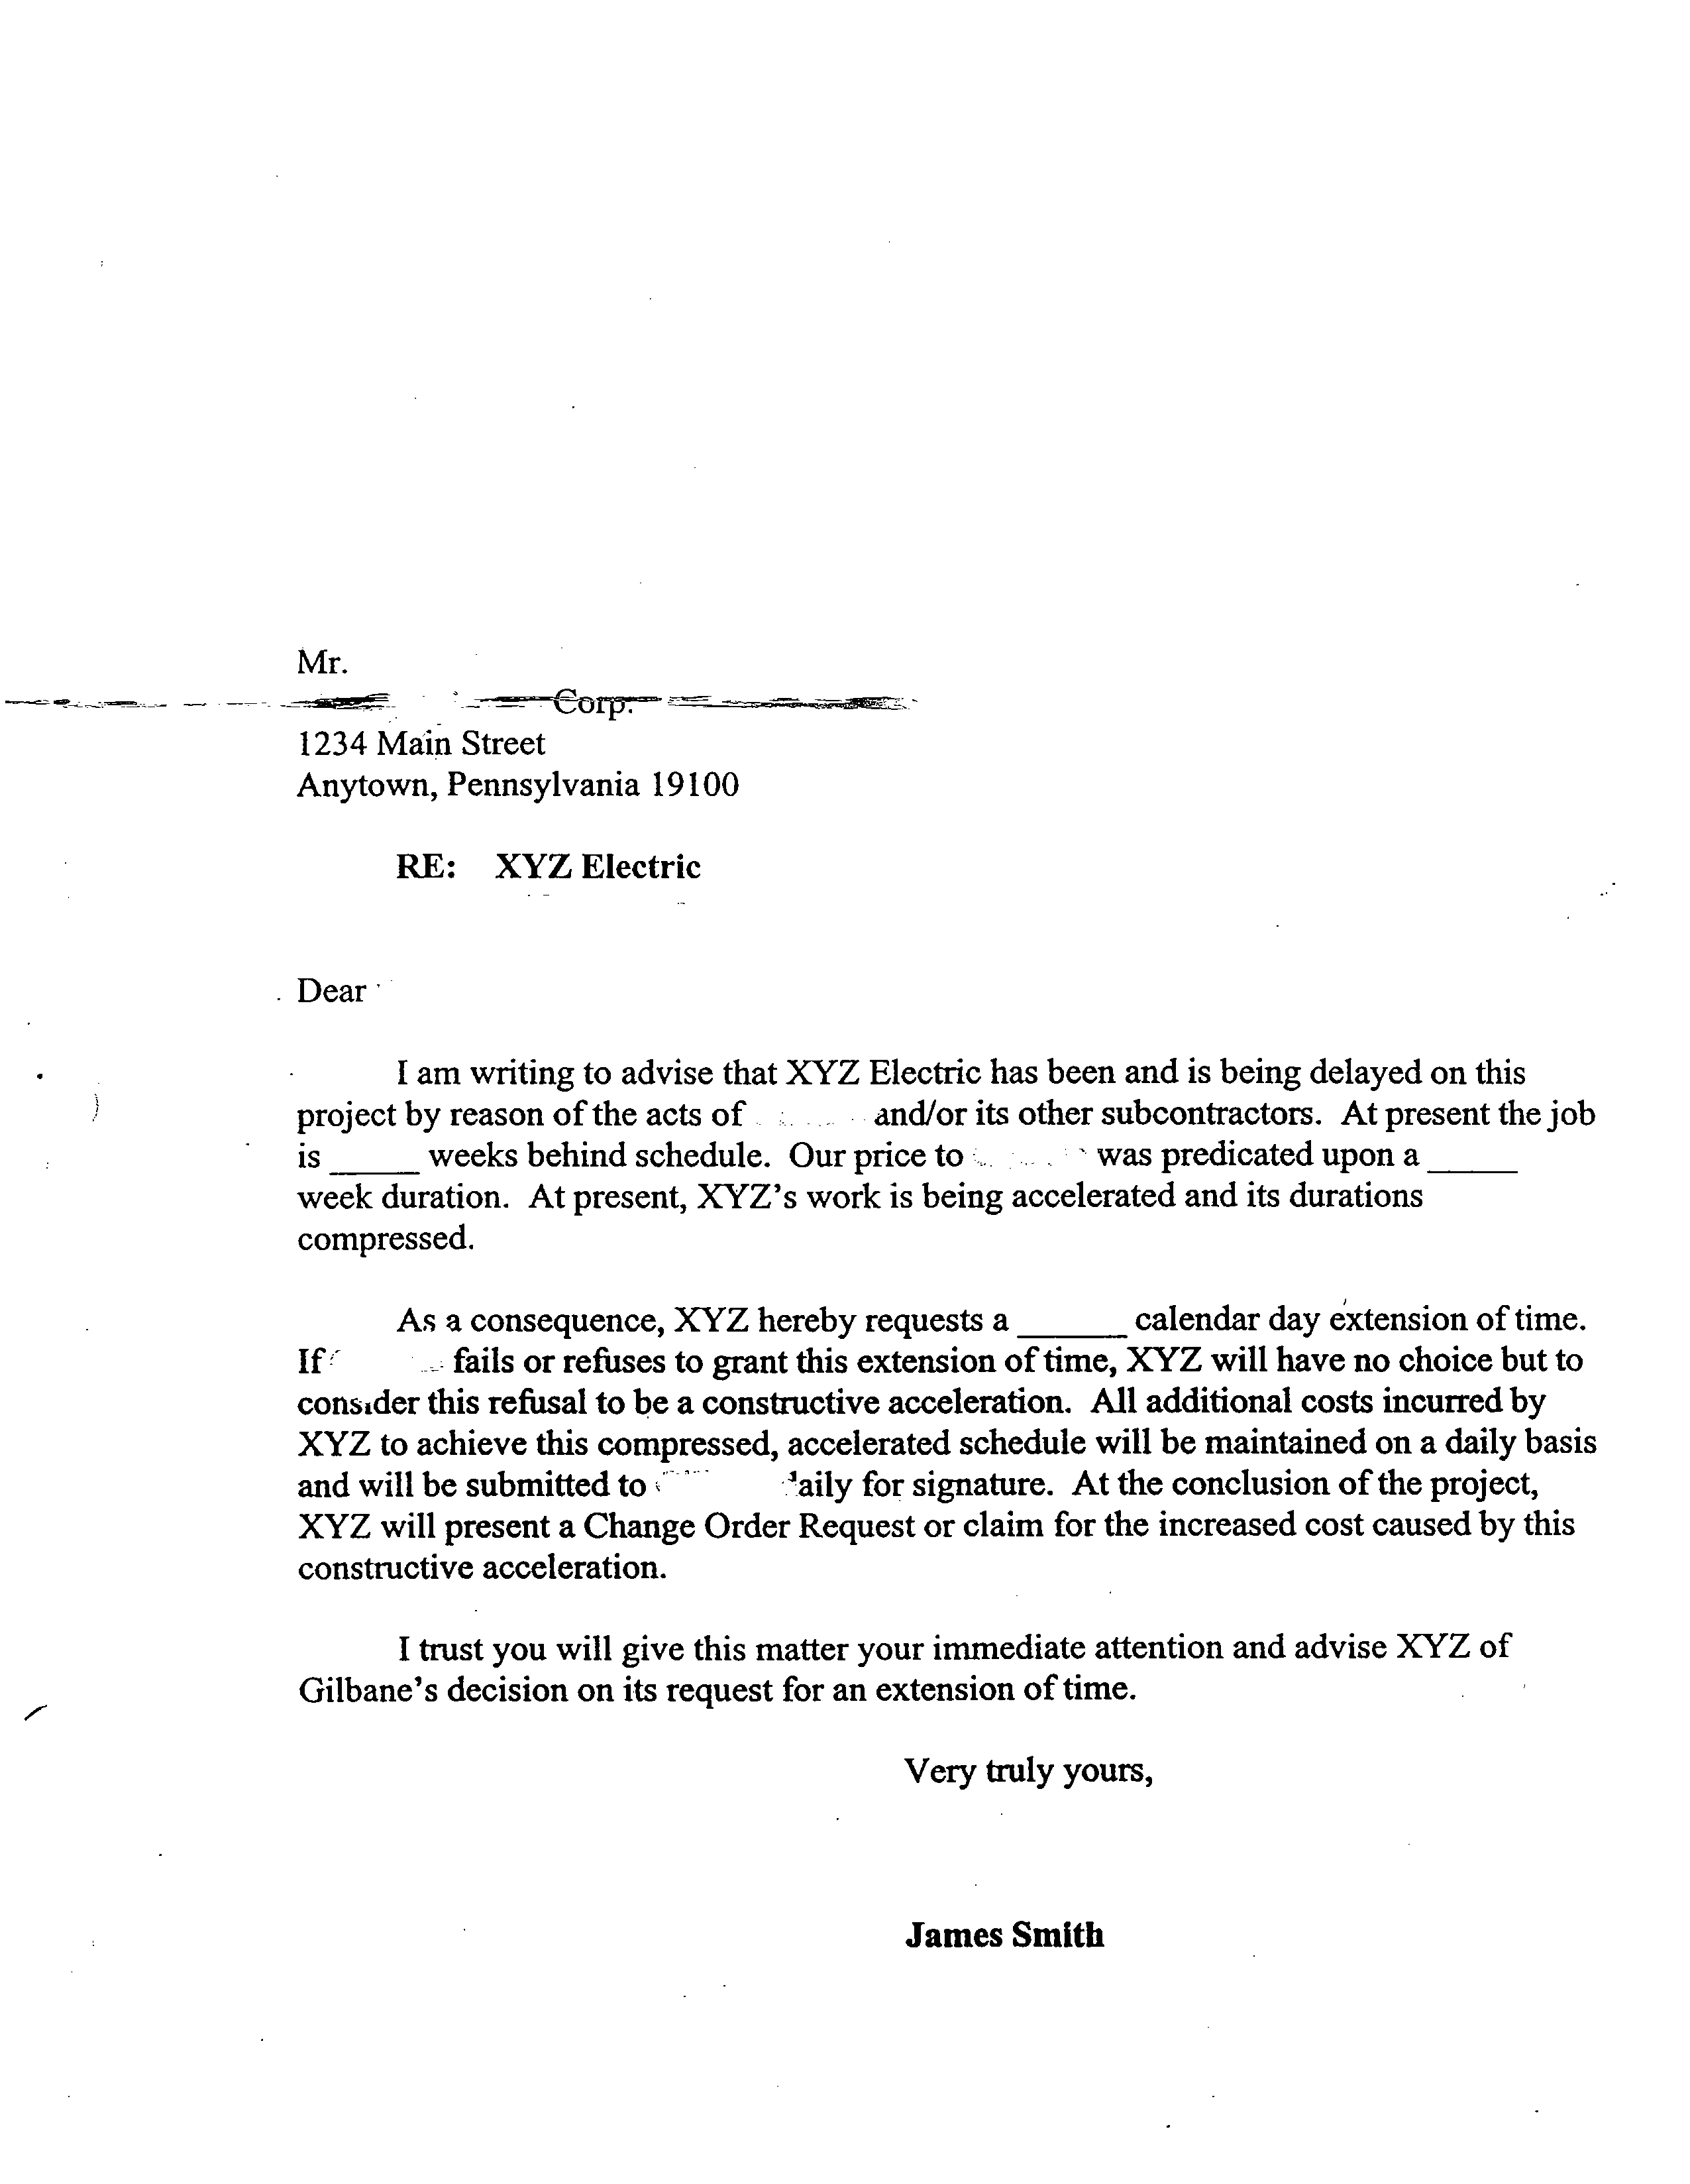
Preserving acceleration claims (paper Trail)

Slide 64

If you take anything from today
Write early and write often!

Slide 65
Questions?

Slide 66
Contact Information
Philadelphia
30 South 17th Street
19th Floor
Philadelphia, PA 19103
Phone: 215.564.1700
www.cohenseglias.com
Dan Fierstein | Associate
(D) 267.238.4765
dfierstein@cohenseglias.com
Matt Gioffre | Associate
(D) 267.238.4748
mgioffre@cohenseglias.com

