Slide 1

Prompt Payment Clauses:
What to Watch For and How to Negotiate
ASA Presentation |January 7, 2020
Presented by
Jim Yand and Brian Esler, Partners
Miller Nash Graham & Dunn LLP

Slide 2
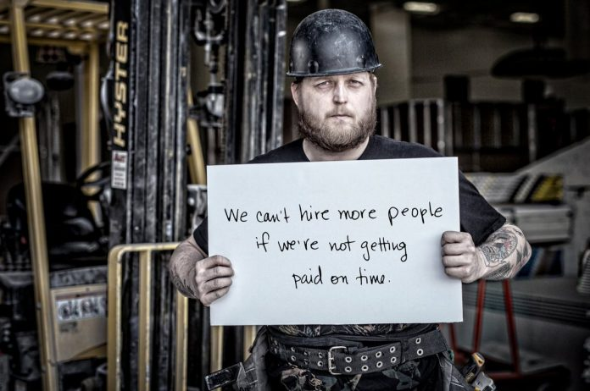
Payment is Job #1
AWCI reports that, for the last two years, prompt pay has ranked highest among concerns of its members.
http://www.awci.org/cd/pdfs/9708_a.pdf
Image: Prompt Payment Ontario

Slide 3


Second That…
The American Subcontractors Association states that “slow pay ranks as the number one concern” among its members during their annual legislative survey.
https://www.asaonline.com/eweb/tcc/TCCJun2017/tcc_2017_Jun.pdf

Slide 4
The Time is Now
At the ENR Risk Summit in 2013, subcontractors complained about payment abuses, stating strongly that “we need to lead the industry kicking and screaming to payment reform.”
ASA President Brian Johnson in his March 2015 letter to membership cautioning that Textura’s Early Payment Program “does not improve the approval timeline by the GC of a submitted subcontractor/ supplier invoice.”

Slide 5

Prompt Payment:
It’s the Engine That Delivers Success
This program covers:
How to approach the prompt payment terms in your contract
Use liens and payment bonds to get paid
Five steps you can take to increase chances for prompt payment
What to do when payment is not made

Slide 6

Are We Contractors or Bankers?
The Problem
“Most contractors take 45 to 90 days to pay us. It’s not good for us and kills cash flow. We spend a lot of time on the phone trying to collect money when we should be doing other things.”
- Gary Adams, President
Adams Construction Services, Inc. Atlanta, GA

Slide 7
How to Approach the Prompt Payment Terms in Your Contract
Prompt Pay due on Public works projects (why not on all projects also?)
Negotiate Prompt Pay Clause in contract (and put it in the bid before negotiations start)
Avoid “Pay if Paid” (Pay when Paid as alternative)
  The GC may be relieved of any obligation to pay its subcontractors for the conforming work they performed
  Subcontractors may be denied the right to recover against the contractor’s payment bond posted
Subcontractor must rely on the creditworthiness of the Owner rather than Contractor (owner is often a single asset LLC)

Slide 8


Industry Standard is Prompt Pay
AIA Form A401 (Pay when Paid)
ConsensusDocs Form 750, Standard Agreement Between Constructor and Subcontractor (2011),¶ 8.2.5. states:
  TIME OF PAYMENT: Progress payments to the Subcontractor for satisfactory performance of the Subcontract Work shall be made no later than seven (7) Days after receipt by the Constructor of payment from the Owner for the Subcontract Work. If payment from the Owner for such Subcontract Work is not received by the Constructor, through no fault of the Subcontractor, the Constructor will make payment to the Subcontractor within a reasonable time for the Subcontract Work satisfactorily performed.

Slide 9

Reality Check
Pay if paid is reality of subcontract world and most GC require it (although not in all states, see ASA Contingent Payment in 50 states chart)
Most live with it because the GC has a good payment history so it does not bite…
Yet!

Slide 10
Negotiation Tips
Option #1: Offer alternate lower bid for Prompt Pay
Option #2: Pay when Paid (reasonable time after GC receives payment)
Option #3: “Subcontractor acceptance of the conditional payment terms is conditioned on the understanding that those terms apply solely to monies withheld by the Owner due to some deficiency of the Subcontractor’s Work.”

Slide 11
Role Play
GC: Your competitors never raise questions. Why should you be any different?
Sub: We take our contractual obligations seriously. We believe the best way to give you the results that you want at an attractive price is to have equitable subcontract terms. You do the same with the owner.
  Warning Tip: If you start work before signing a subcontract, the GC can assert this is a form of acceptance of their terms. (Solution: Send your form of subcontract and then start discussions.)

Slide 12
Defenses to “Pay if Paid” Clauses:
Contrary to lien statute protecting their right for payment. RCW 60.04.021
RCW 60.04.035 prohibits coercion in asserting mechanic’s lien claims in advance of those claims arising. PIP clauses might be a form of improper coercion
RCW 4.24.360 prohibits any “no damages for delay” clauses
  Therefore, any construction clause that prevents the subcontractor from asserting claims for delayed payment might arguably be void
Against Public Policy (but not Washington/Oregon). WRM Clark Corp. v. Safeco (Cal. 1997)(PIP unenforceable).

Slide 13

Use Liens and Payment Bonds to Get Paid: Public Works
Payment Bond required on Public Work Jobs
  Combine bond claim and retainage lien claim foreclosure suits
  Claimant can recover attorneys’ fees from surety if surety is found to have used its superior financial position to continue the suit to the disadvantage of the claimant.

Slide 14
Use Liens and Payment Bonds to Get Paid: Private Work
Claim of Lien
  In Washington, the lien must be filed within ninety days of last delivery of materials or wok by the claimant
  Practice Tip: File the claim well within ninety days of substantial performance to ensure that the claim is timely
Contractor must be registered to file a lien or assert a claim for breach of contract

Slide 15
Attitude: Get Lien and Mean
The strongest weapon the subcontractor has is one that has been around for a long time, the lien
Many subcontractors don’t evoke the lien for fear of alienating their contractors
Add to the contract that liens will be filed after 30 days for late payment and that GC has 15 days to dispute the amount of any pay application or waived
Liens typically filed in only 1% of projects and only 20% end up in litigation.

Slide 16

Who Said It…?
“When you work for people you don’t know, you’re asking for trouble.”
- Gary Adams, President
Adams Construction Services, Inc. Atlanta, GA

Slide 17

Five Steps You Can Take to Increase Chances for Prompt Payment
Contractual right to prompt payment
  Use Public Contracts as Example: Payment due within ten (10) days
  Invoice promptly with right information
Right to Stop Work (most effective method)
Right to Interest (penalty) and Attorney Fees (fixed amount added for each default)
Discount for prompt pay (easy payment options)
Nonpayment will invalidate contractual warranties
YOU ARE NOT A BANK, SO STOP TREATING YOURSELF LIKE ONE

Slide 18
What Are Your Rights With Retention?
Ask to release retention once work is complete.
Public works can request retainage be reduced to 100% valuation of the remaining work—RCW 60.28.011(3)
Lien that job at completion if retention is not paid
Seek to bond around holding retention
Cal law: Private owners must pay retainage 45 days after completion of the work—Cal. Civ. Code § 8812(a)
Legislative work to do to get private work covered

Slide 19
What to Do When Payment is
Not Made
Confirm if payment is disputed/non-disputed
Non-disputed amounts should be paid immediately (send letter and email)
Disputed amount should be documented and set for resolution promptly (meet, mediation, litigation)
Exercise remedies in contract (high level call, stop work notice, interest penalties, filing of lien)
Know your GC (talk to the right person)
Oregon's PPA provides for civil penalties or sanctions, or even termination of a contractor's license for repeat offenses— Or. Rev. Stat. § 701.992

Slide 20
Take the Test
Is Prompt Payment included in your contract?
Timing of payment (ten (10) days)
  No pay-if-paid (conditional payment) but pay- when-paid
Avoid Choice of Law or Venue Clauses for out of state
Request payment bond (if slow or no pay history)
Interest and attorney fees on late payments
Right to stop work (no extra work if unpaid balances due)
YOU ARE PUTTING YOUR MONEY AT RISK

Slide 21
General Contractors Love to Say That They “Didn’t Know”
SOV or Billing should include an accurate accounting that clearly indicates:
  Original contact amount
  Change order log
  Amount paid-to-date
  Outstanding amount owed
  Revised contract amount
Request at least monthly meetings with the GC to review the Change Order Log
Keep the costs in their face at every opportunity
21

Slide 22
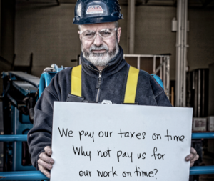
Pay-to-Play: Really?
“Contractors have no guilt about keeping your money. They expect you to organize the job, get it scheduled, pay out your own money for the materials and carry your own payroll. Then they hold out on paying you. And then if you have a chance to make a little profit, they try to back-charge you. It’s a constant hassle.”
- Jerry Screws, Vice President
Drywall Connection
Avada, CO

Slide 23
Ten Tips to Getting Paid
Be selective in the contractors you work for (best GC gets best price)
Review all receivables on a monthly basis so that you are up-to-date on all charges
Strike objectionable language from the contract
Stay on top of all the financial transactions throughout the entire process
Have a CPA or other financially trained person be in charge of collectibles
Source: AWCI Article

Slide 24
Ten Tips to Getting Paid, cont.
Make copies of accounts receivables due to all key personnel
Get to know the owner, architects, board members or administrators of the project you are working on
Reserve the right to stop work
After 60 days, file a lien
Work with your colleagues and associations long range to pass laws in the state legislature ensuring fair payment
Source: AWCI Article

Slide 25

Deal Breakers: GC, You’re Fired!
Bid Shopping (breach of trust)
  The AGC calls the practice of bid shopping "abhorrent" and proclaims that it is "resolutely opposed" to it
Timeliness of Payment
Dispute or claim history
Retainage Practices
PM/Superintendent Problems
Big reason for subs going bankrupt is lack of working capital

Slide 26

Last Word
“Being satisfied with less volume but staying with good contractors sure beats running around the countryside with lawyers trying to get your money.”
- Grady B. Botens
Botens Commercial Systems Inc.
Windermere, FL

Slide 27
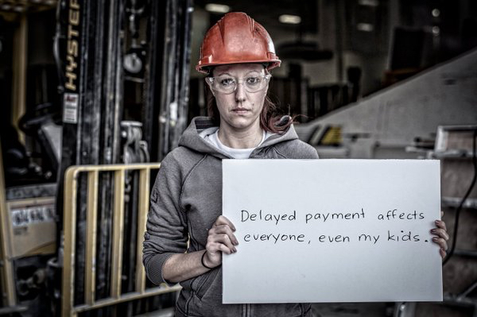
Questions?
Image: Prompt Payment Ontario

Slide 28
Thank You!
Jim Yand, Partner
Miller Nash Graham & Dunn LLP
206.777.7404 | james.yand@millernash.com
Brian Esler, Partner
Miller Nash Graham & Dunn LLP
206.777.7415 | brian.esler@millernash.com

