Slide 1
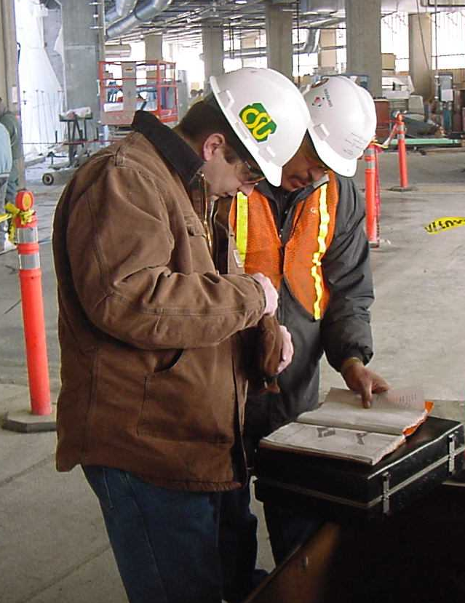
Total Worker Health®
Mike Van Dyke, Ph.D., CIH
1

Slide 2
Goal
Introduce you to a new way of thinking to protect and promote your workforce’s health, safety, and well-being.
Provide you with a method to get started.

Slide 3

Scope of the Problem: U.S. (2018)
14 people die each day of work-related injuries
2.8 million people get injured at work each year
430,000 occupational illnesses
1 in 30 chance of workplace injury
1 in 100 chance of serious workplace injury
1 in 28,000 chance of workplace fatality

Slide 4
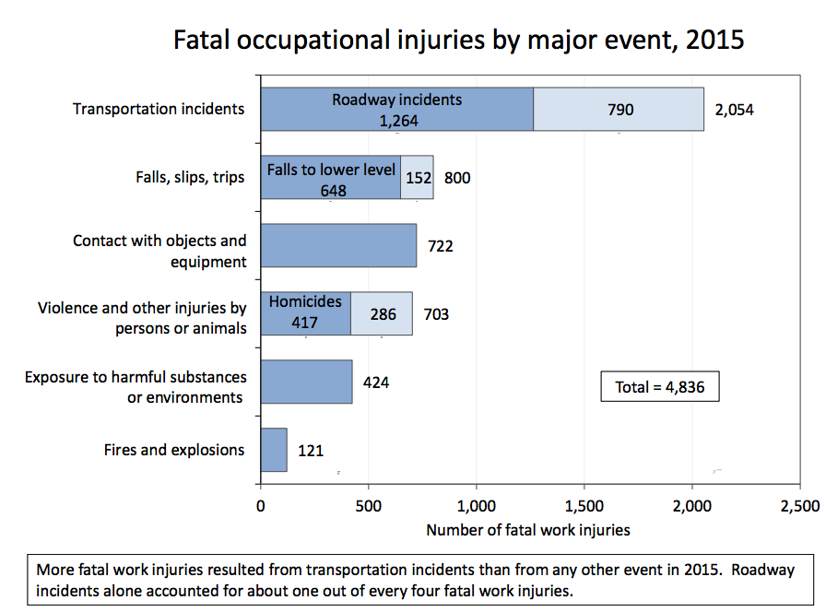
Notes:
What do you think the major cause of these fatalities are?
It’s the transportation accidents...such as driving trucks to and from construction jobsites. It’s also falls to a lower level while working on residential construction job sites.

Slide 5
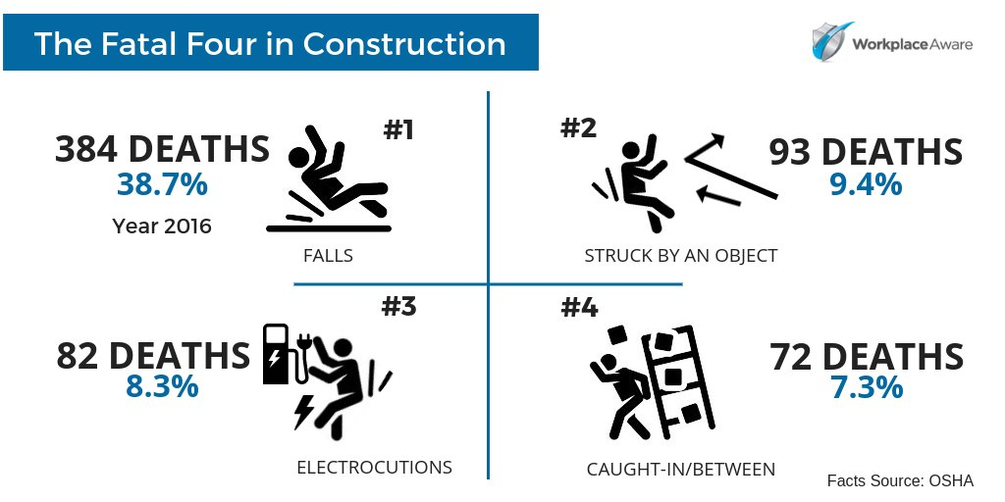

Slide 6
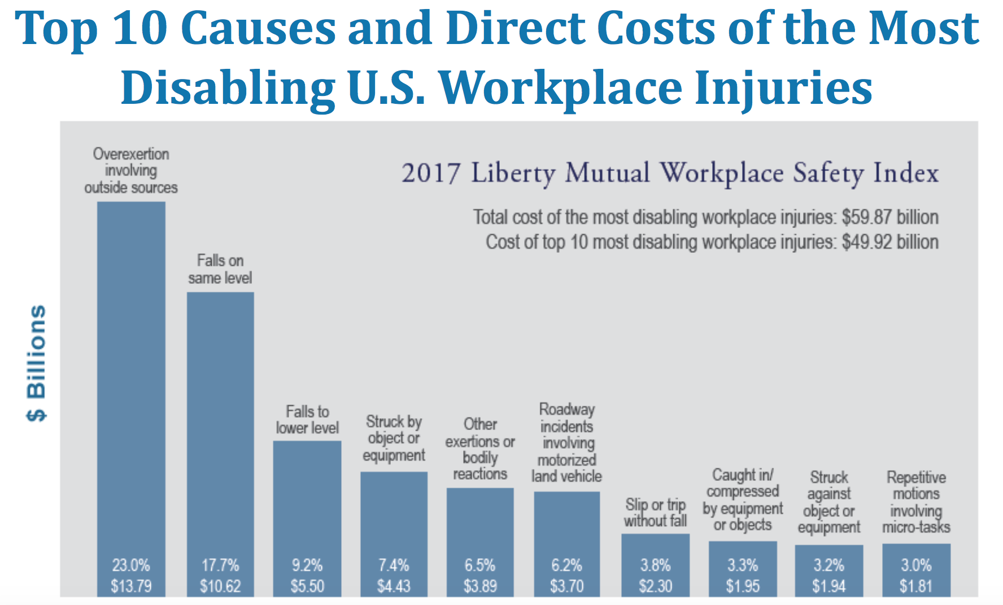
Notes:
Workplace injuries can be very disabling. Overexertion injuries account for ¼ of all disabling injuries – think back strains, shoulder injuries, etc. from overuse.

Slide 7
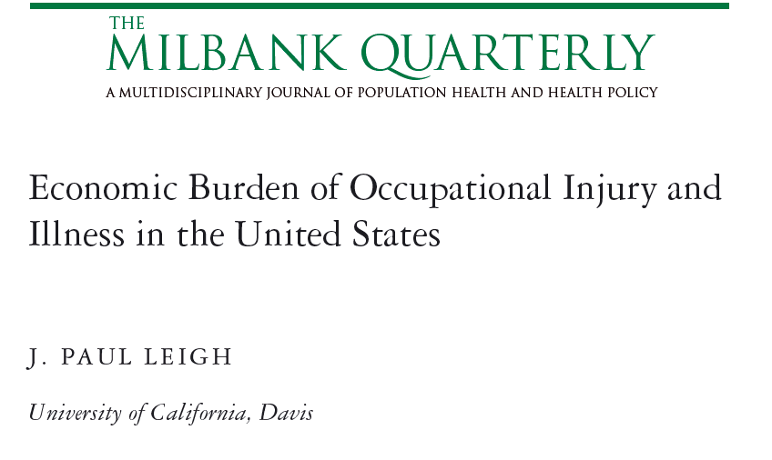
Economic Impact of Workplace Injuries
$250 Billion
Fatal Injuries | Non Fatal Injuries | Fatal Illnesses | Non Fatal Illnesses
5,600 | 8,559,000 | 53,000 | 427,000
$6 Billion | $186 Billion | $46 Billion | $12 Billion
2011 (2007 data)
Notes:
The bad news is that workplace injuries are costly.
$250 billion per year as of 2007
I’m sure you feel the cost of a injury both in terms of your premium, but also in terms of indirect costs such as ...
Heart disease 220 billion
Cancer 80 billion

Slide 8
The “work-centered” approach to safety

Slide 9
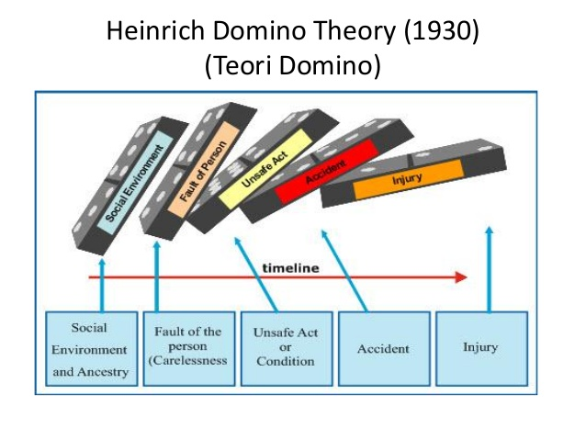
Safety Engineering

Slide 10
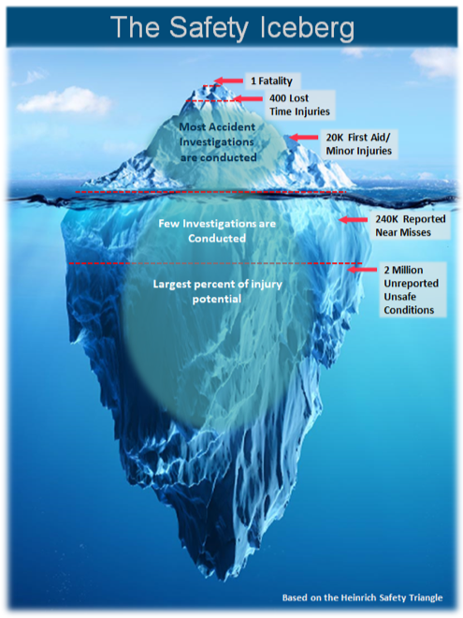
Focus on Unsafe Conditions
Engineering controls
OSHA compliance
Hazard audits
Increase reporting of hazards

Slide 11
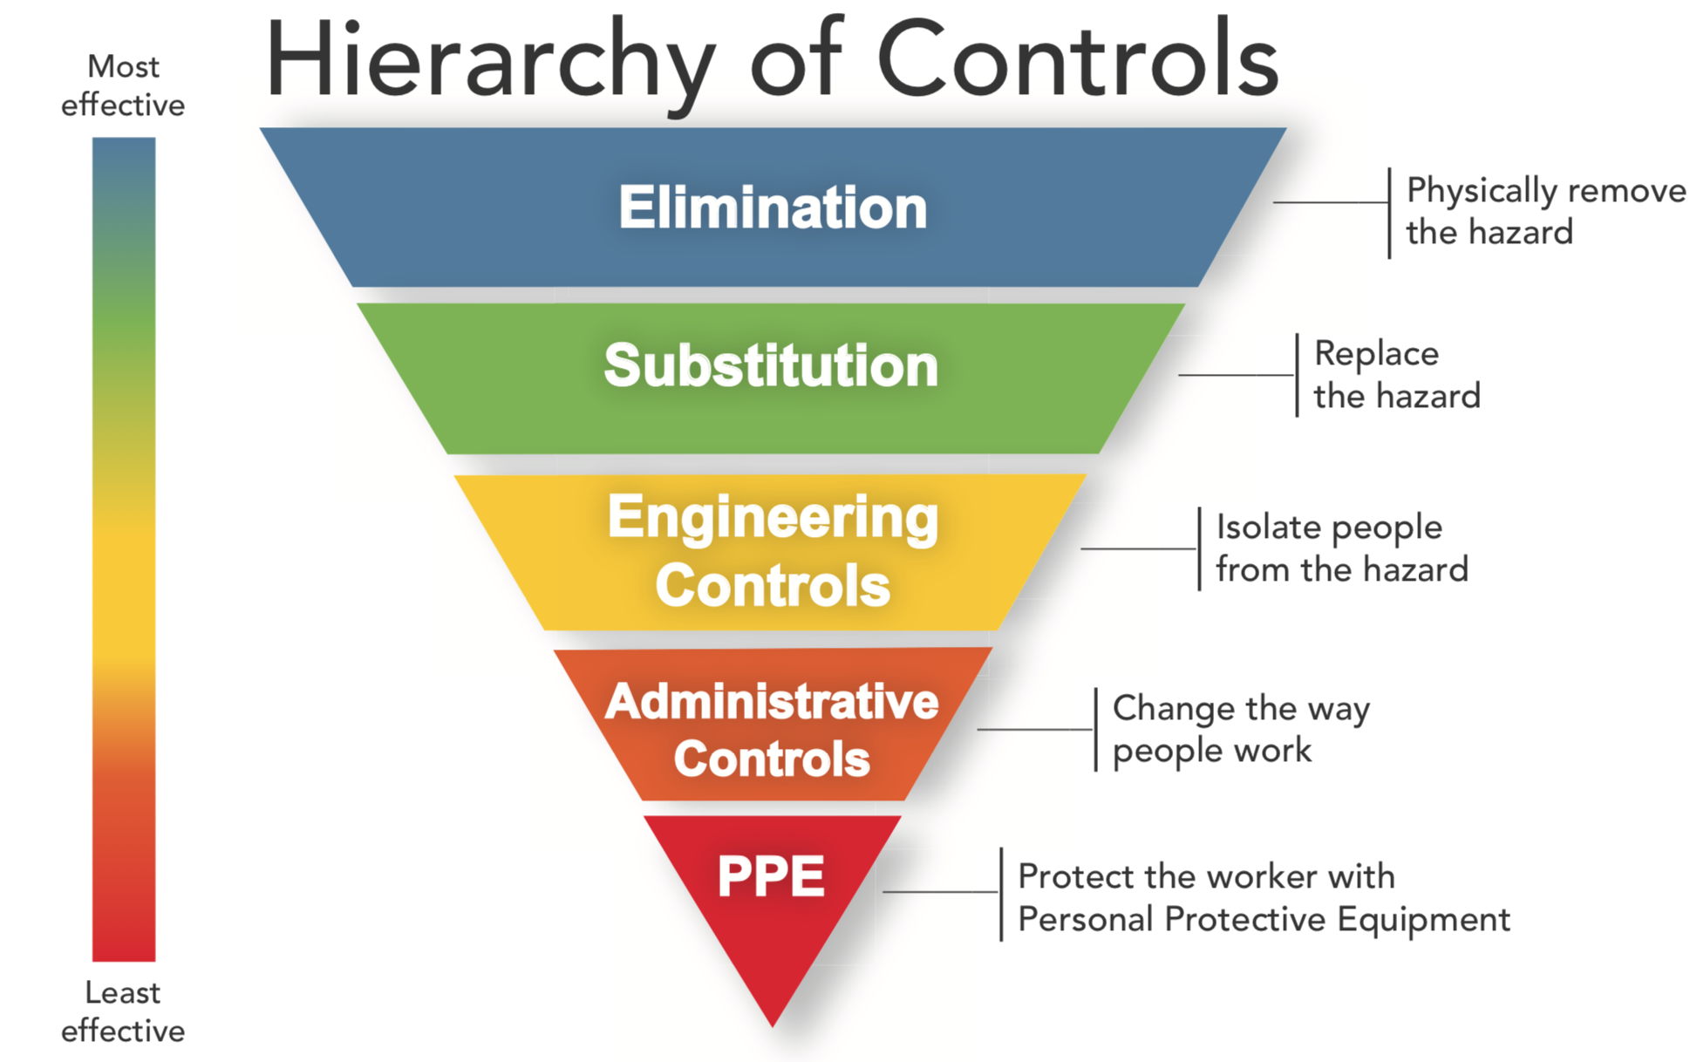

Slide 12

Focus on Unsafe Behaviors
Behavior-based safety
Worker training
Safety coaching

Slide 13
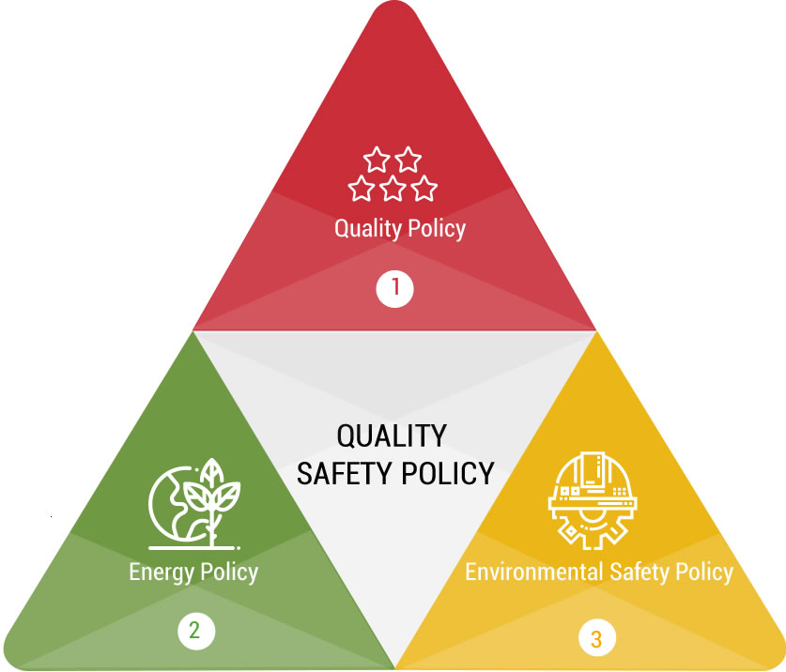
Systems Approaches to Safety
Policies
Checklists
Job hazard analyses
Safety management
Integration with quality programs

Slide 14
What about the individual workers?

Slide 15
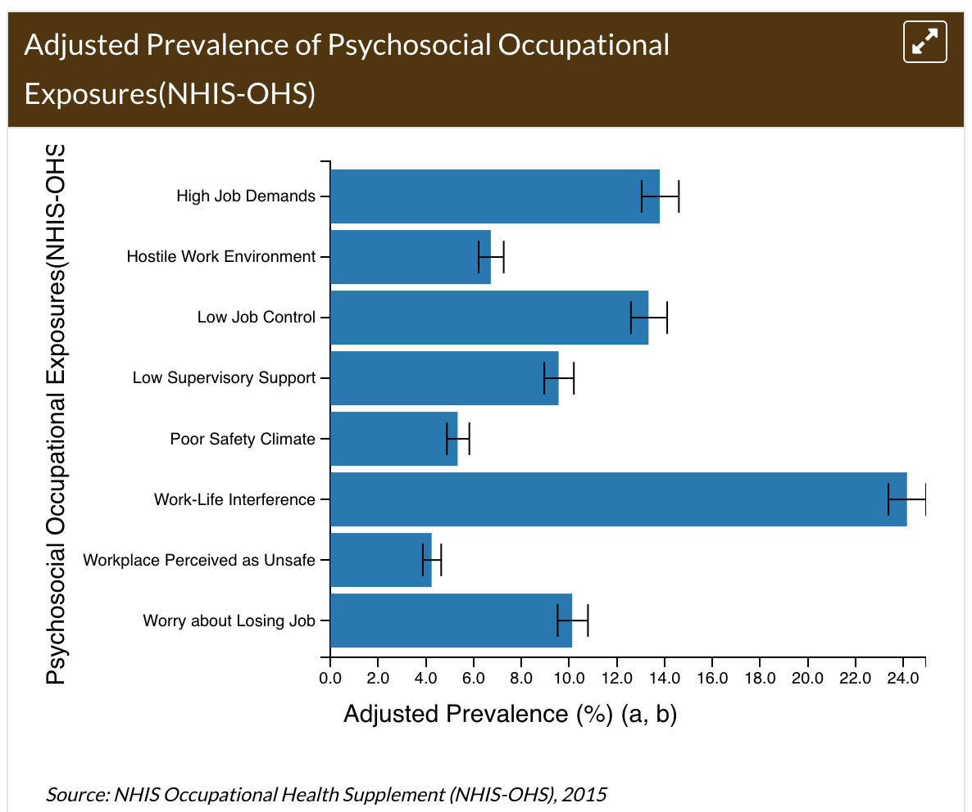
Workers report psychosocial occupational exposures

Slide 16
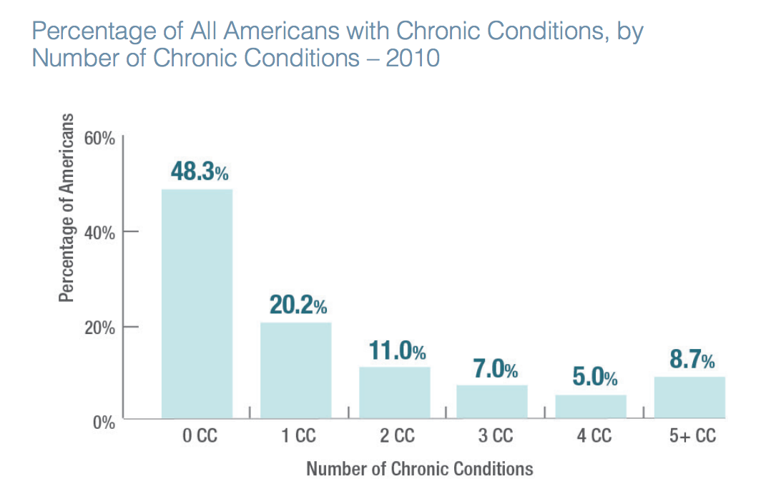
Workers are working with multiple chronic health conditions
52%
Notes:
Switching gears...lets talk about workforce health in general. Half of Americans have at least 1 chronic health condition. And these conditions are costly...

Slide 17
Percentage of Colorado workers with lifestyle & behavioral health conditions, 2010-2014
Notes:
For example, work that we’ve done at the CHWE has shown that workers in Colorado have a significant number of health risks.
The most common concern we found was for abnormal BMI and stress over finances...over half of the workers in our sample had this health concern. They also reported a significant amount of poor sleep, poor lifting practices, poor exercise, stress at work, depression etc.

Slide 18
Do individual factors affect safety at work?

Slide 19
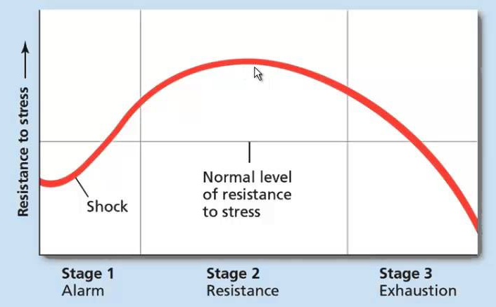
Chronic stress
Employees who are stressed at work are 22% more likely to suffer a work-related injury.
Job stress is more strongly associated with health complaints than financial or family problems.
  St. Paul Fire and Marine Insurance Co.
Notes:
40% of workers report their job was very or extremely stressful. NIOSH funded study
Job stress is more strongly associated with health complaints than financial or family problems.
Pinnacol found employees who are stressed at work were 22% more likely to suffer a work-related injury.
Schwatka, N.V., et al. (2016) Health risk factors as predictors of workers’ compensation claim occurrence and cost. Occupational and Environmental Medicine, Published Online First: 16 August 2016, 1-10. doi:10.1136/oemed-2015-103334
“When compared with business units in the bottom quartile of engagement, those in the top quartile realized improvements.”
Include elements of engagement. Means that it’s not just the absence of stress, but the inclusion of meaning/purpose, self-direction, growth, and connection. All of these are possible at work. Gallop Employee Engagement poll showed those in “engaged business units” had 70% fewer employee safety incidents
[Add reference to the percentages of other things like turnover and productivity.]

Slide 20
Dow Chemical Analysis: Link between health and safety
Health Risk Factor | Odds ratio of experiencing a Safety Incident or OTJ Injury
Health Conditions | 2.0 - 2.6
Perceived Health Status | 1.6
Stress | 1.7 - 2.0
Fatigue | 1.7
Alcohol | 1.7
BMI | 1.34
Tobacco | 1.7
Physical Activity | 2.0
Source: Dr. Cathy Baase
Corporate Medical Director, Dow Chemical
Freewynn, 2018 WCI Conference, Orlando, FL

Slide 21
The Monetary Link Between Health and Safety
*Average cost of Workers’ Compensation Injury = $7K
1 comorbid condition = $13K
2 comorbid conditions = $30K
3 comorbid conditions = $90K
*Source: Todd Hohn, Global Director,
UL Integrated Health and Safety Institute
Freewynn, 2018 WCI Conference, Orlando, FL

Slide 22
Making the argument…
Personal risk factors
Chronic disease
Stress
Fatigue
Substance use
Obesity
Fitness level
Work incidents
Transportation
Falls
Trips/slips
Strains/sprains
Repetitive motion injuries
Directly Related

Slide 23
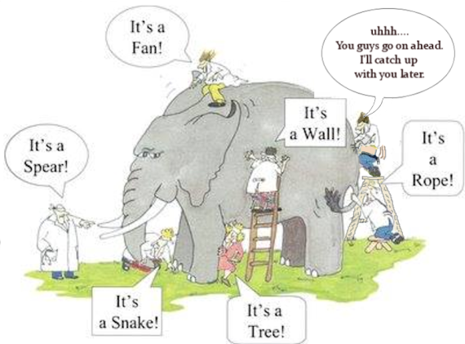
Safety risk factors are complex…
Holistic approach is necessary
Work-centered approach
Person-centered approach

Slide 24
NIOSH Total Worker Health®
Integrating Safety and Health in the Workplace
Keep Workers Safe
Establish Workplace Policies, Programs
and Practices that Improve Health
Improve
Worker
Well-being
Total Worker Health®….policies, programs and practices that integrate protection from work-related safety and health hazards with promotion of injury and illness prevention efforts to advance worker well-being
www.cdc.gov/niosh/twh
Notes:
To help meet this challenge, NIOSH launched the TWH program in 2011 to champion a broad, holistic approach. TWH focuses on P, P, and P that improve the nature of the work itself, maintaining a steadfast commitment to continually advancing improvement of working conditions to most boldly impact safety and health.
First protect the safety of workers, optimizing the way work is designed and carried out. Then, add customized policy, program and practice interventions that take into account the specific safety and health challenges facing workers, at work and beyond. All with the goal of improving worker wellbeing.

Slide 25
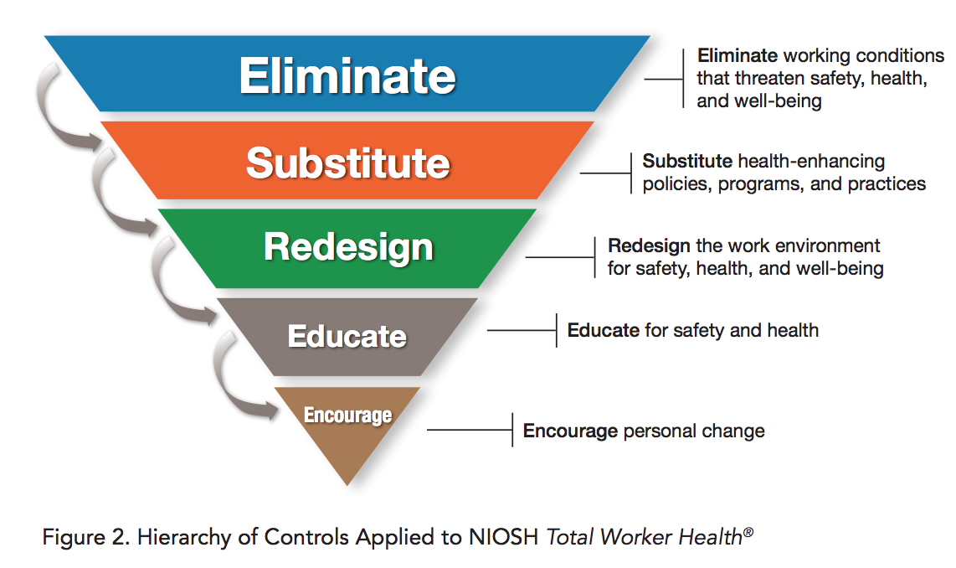
TWH® Framework
Multi-factorial nature of health outcomes
  Personal risks & occupational risks
  Attention to health outcomes not commonly considered related to work
Intervention science
  Focus on changing organizational behavior
  Participatory
Relies on common hierarchy of control principle, and strongly argues that working conditions contribute to poor health and must be controlled before focusing on employee behavior change
Notes:
Most diseases, injuries, and other health conditions experienced by working people are multifactorial, especially as the workforce ages. Evidence supporting the role of work and personal risk factors in the health of working people is frequently underused in developing interventions. Achieving a longer, healthy working life requires a comprehensive preventive approach.

Slide 26
TWH is about changing the design of work to promote well-being.

Slide 27
TWH Attributes
TWH examines how the work itself can influence safety, health, and well-being outcomes, holistically
TWH embraces voluntary, participatory health interventions
TWH programs protect workers’ rights and privacy
TWH does not “blame the worker”
TWH is not about healthcare/health insurance cost-shifting based on underlying health conditions or health habits
TWH is not a “typical workplace wellness program”

Slide 28
In the past...
Everyone goes home the same way they came to work
Vision for the future...
Everyone goes home in better health
Notes:
I’ve been to a lot of safety meetings and spoken to a lot of safety professionals...and i cant tell you how many times I’ve heard ...
But our vision for the future is that ...

Slide 29
Total Worker Health is my job.

Slide 30







Mission
Benchmarks of Excellence
Mission
To collaborate with employers to build a culture of health and safety in the workplace. We aim to help organizations by offering assessment, advising and certification to improve the health, safety and well-being of all workers.
Organizational
Support
Workplace Assessment
Health Policies & Programs
Safety Policies & Programs
Engagement
Evaluation

Slide 31


Questions?
  Mike.VanDyke@cuanschutz.edu

