Slide 1
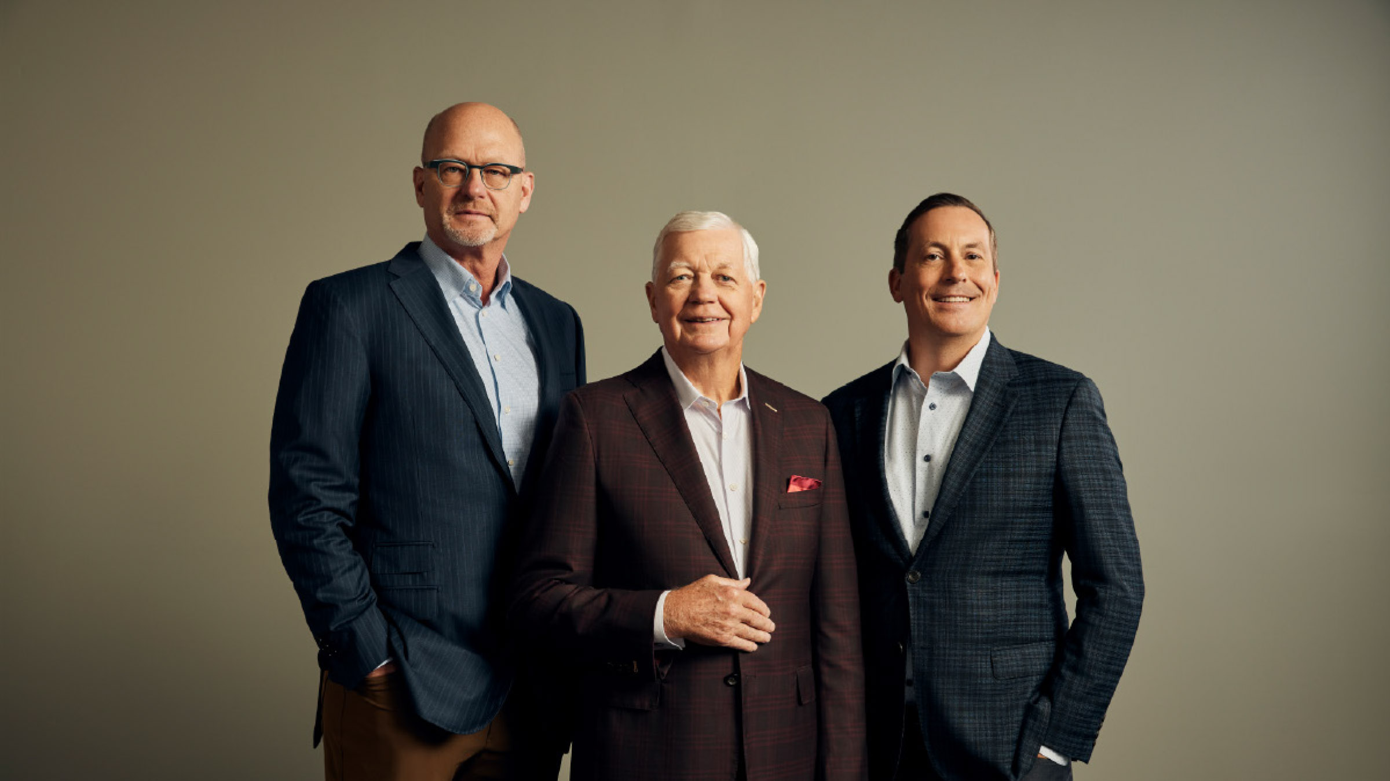
2025 State of the Construction Insurance Market
Gregory Stephens, CLCS CRIS
EVP National Construction Practice Leader
Gary Semmer, CIC CWCA
EVP Construction Vertical Practice Leader

Slide 2

Agenda
2025 State of the Construction Insurance Market
      Insurance Market by Line of Coverage
      Risk Profile Best Practices
      Alternative Risk Marketplace

Slide 3

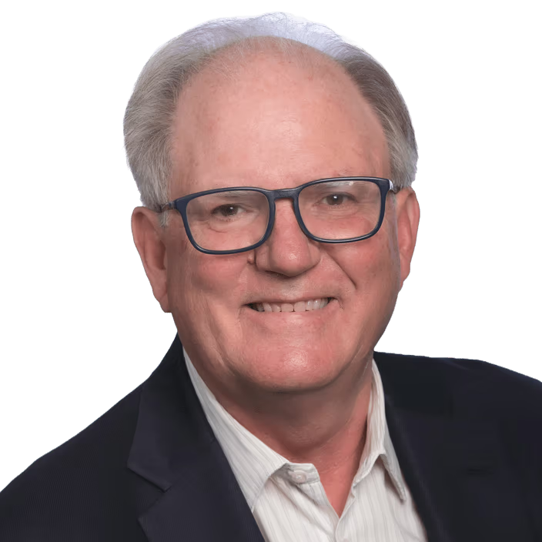
AP Construction Leadership Team
2025 State of the Construction Insurance Market
Gary R. Semmer, CIC, CWCA
Executive Vice President
Construction Practice Leader
Gary.Semmer@assuredpartners.com | 630-544-3788
Gregory Stephens, CLCS, CRIS
National Construction Vertical Leader
Gregory.Stephens@assuredpartners.com | 970-208-6364

Slide 4

Insurance Market by Lines of Coverage
2025 State of the Construction Insurance Market
  Workers Compensation
      Stable outlook for near future with pricing flat to -5%.
      However, watch for a rate tick-up if WC Claim frequency increases.
  Property (Permanent Property Bldgs. & BPP) ,Builders Risk, Installation coverage and Contractors Equipment)
      If you're situated in a CAT Zone (Coastal, Wildfire, Convective storms, etc.), expect pricing increases in the 10%-20% range.
      Outside of CAT areas more moderate rate increases in 5% 10% range. Consider higher deductibles to lower your premiums.
  General Liability
      Expect rate increases in the 5%-10% range and if you’ve had claim activity rates can be in the 10%-20% +.
      Watch for coverage restrictions and exclusions on renewals.
  Business Auto
      Expect rate increases in the 10%-15% range based on increased cost of Vehicle repairs, Medical expenses and Liability settlements.
      Consider increasing your deductibles to lower your Comp & Collision premiums.

Slide 5

Insurance Market by Lines of Coverage
2025 State of the Construction Insurance Market
  Umbrella/ Excess Liability
      The insurance market is experiencing a major uptick in GL & Auto Liability claims based on nuclear awards/settlements that have penetrated the Umbrella/Excess Liability layers of coverage.
      In turn, causing carriers to restrict how much UMB Limits they are willing to put up on renewal and in certain instances reducing limits, which is causing an increase in pricing.
      Expect a 10%-15% increase in pricing at the UMB level, possibly higher if you need Excess Liability above the UMB.
  Contractors Professional & Pollution Liability
      Good news - this is an area where claims have moderated over recent years, and with more carriers in the marketplace, capacity has increased and rates are flat to down 5%.
      Watch out for requests for higher Limits from Developers & GC’s on larger projects.

Slide 6
Improve your Risk Profile: “Best Practices”
2025 State of the Construction Insurance Market
The Construction Industry is facing a number of external challenges from labor shortages, material price inflation, some supply chain delays. This all translates into scheduling, productivity and profitability issues. Although, you may not have control over these external factors you can help control your Total Cost of Risk: TCOR= Premiums, Deductibles paid + Risk Management expenses/Construction Revenues.
Construction Industry TCOR- acceptable range is .005% to 1.5% of Revenue in most trades to maintain a “competitive” advantage.
Best Practices to achieve these results:
1. Safety/ OSHA Compliance
        Review every element of your Safety Program (Manual, Employee Orientation & Training).
        Consider performing a “mock” OSHA audit to identify safety hazards and what to do if you have an OSHA visit or audit.
2. Claims Management
        Review your past 5 years of Claim History/ Loss Experience for frequency trends and severity claims to determine how you can avoid or mitigate future claims.
        Perform periodic claims reviews with your Insurance Broker and Insurance Carrier Claims reps to close out old claims that can impact your WC EMR, General Liability, and Business Auto premiums.
3. Contract Review
        Set up a standard Contract Review process to make sure your insurance program complies with the insurance requirements in the contracts you’re signing.
        This will avoid “surprises” when you’re looking to get paid or if an “uncovered” claim occurs post completion.
4. Renewal Preparation
Making the above steps an “ongoing” process will put you in the most favorable position as you start the renewal process 3-4 moths prior to your renewal dates.
              Meet with your Insurance Broker to review renewal updates- Payrolls, Sub-Work values, Equipment lists and any changes in scope of work for the upcoming term.
              Based on market conditions, discuss with your Broker your current Carriers’ renewal appetite and whether you need to go to market to seek alternative proposals and which carriers to approach.
              Set up possible Risk Control meetings with various carriers and schedule a meeting 3 weeks prior to renewal date with your Broker to go over renewal alternatives.

Slide 7

Alternative Risk Marketplace
2025 State of the Construction Insurance Market
      In going through the renewal process, you may find that you can accept more risk by securing higher Deductibles/Retentions on WC & GL. Conversely, you may be “captive ready,” and may want to explore a Construction Group Captive.
      WC & GL High Deductible programs:
        Perform a 5 Year Claims Analysis to determine what your average losses are and what levels you can afford to retain more risk
        Determine what the Insurance Carriers collateral requirements are
      Construction Group Captives: Perform a Captive feasibility study to determine if you're eligible and what the potential cost savings over a 5 year period and the Equity buy-in requirements.

