Slide 1

State of the cyber insurance marketplace
Adam Connor
Paul Caron | 7/14/2021

Slide 2


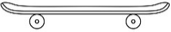


The Evolution of Cyber Insurance
Welcome to the Teenage Years
Pre 2013
Infant
2013 – 2018
Toddler
Teenager
2021
Pre-teen
Emergence of many new entrants from tech E&O world
Designed to cover loss affecting the insured’s network only
Security breach/hack was the sole trigger
Still relatively expensive
Focus =“data breach”
Media: limited, specific to insured’s website
Business interruption
Crime – not included
Unbridled energy
Irrational behavior
2019 – 2020
Tons of capacity
Rush to coverage innovations
The move from “data breach” to “privacy breach”
Expanded Media to include social media and off-line
Broadening triggers for Business Income
Significant expansion of “cybercrime
Lower filed rates
The start of risk management offerings
Social Engineering, FTF, Phishing
Many new entrants, grabbing market share
Filed rate reductions by many admitted markets
Losses increase significantly:
Further expansion of state privacy laws (ie: CCPA in 2020)
Emergence of more insurtechs
Ransomware
Social Engineering
Business Email Compromise
More national headline breaches
Oops – did markets reduce rates and ease underwriting requirements too soon?
The birth of a new coverage
Confusion – wanting to be like the other, more profitable lines, just not sure how to get there
Problems have become much more expensive
New rules needed to establish boundaries (MFA, RDP Config, Endpoint protection, backups, etc.)
Parents (underwriters) asking more questions, establishing curfews
Limited capacity (“Your allowance used to be $10, now it’s $2)
Some kids leaving the neighborhood (Amlin, ArgoPro)
The real fun is just getting started!
Download: The Evolution of The Cyber Insurance Market ©2021 Risk Placement Services, Inc.

Slide 3
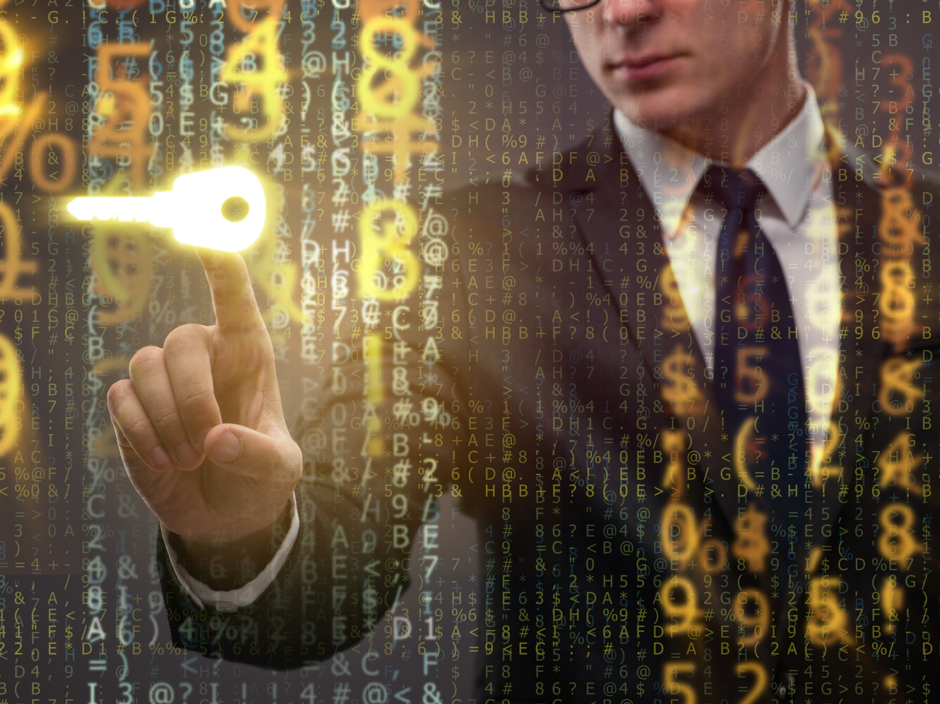
What are we seeing?
Q1 2021

Slide 4
Q1 2021: What Are We Seeing?
Significant premium increases 20-60% or more
Carrier efforts to recover from losses primarily driven by ransomware claims:
  Sub-limits or Cyber Extortion exclusions
  Higher retentions
  Co-insurance
  Reduced capacity
  Expansion of underwriting requirements (Ransomware supplemental apps, scans)
  Reduction in broker compensation

Slide 5
Q1 2021: What Are We Seeing?
Increased carrier concern over systemic/aggregate risk (ie: SolarWinds)
Carriers more willing to walk away from opportunities they don’t find profitable
Hardest hit industries:
  Public entity/govt/edu
  Manufacturing
  Construction
  Healthcare
Carriers exiting the cyber insurance space

Slide 6
Q1 2021: What Are We Seeing?
Further regulatory intervention
  NYDFS Guidance 2/4/21: Cyber Insurers Doing Business in NY Must Implement a Cyber Insurance Risk Framework:
    Establish a formal cyber insurance risk strategy
    Manage and eliminate exposure to silent cyber insurance risk
    Evaluate systemic risk
    Rigorously measure insured risk
    Educate insureds and insurance producers
    Obtain cybersecurity expertise
    Require notice to law enforcement
    Source: Insurance Circular Letter No. 2 (2021): Cyber Insurance Risk Framework | Department of Financial Services (ny.gov)
  October, 2020 Advisory on Potential Sanctions Risks for Facilitating Ransomware Payments – U.S. Department of the Treasury.

Slide 7
How did we get here?

Slide 8
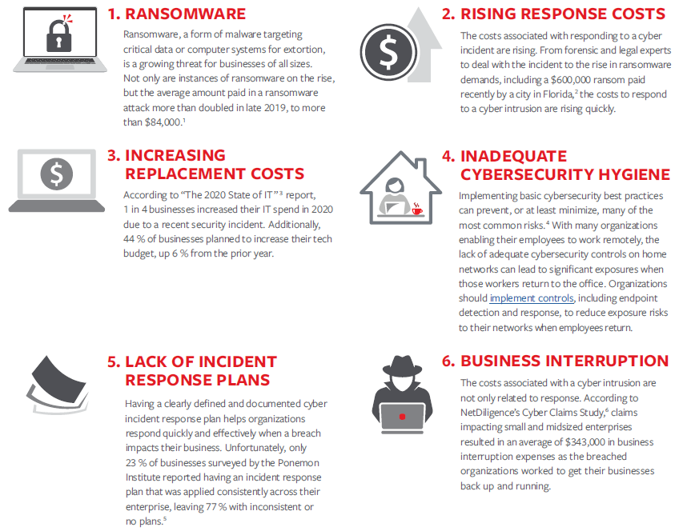
How Did We Get Here?
Source: Travelers
1 Average Cost To Recover From Ransomware Skyrockets To Over $84,000 (forbes.com)
2 Florida City Agrees To Astonishing $600,000 Ransom Payout (Updated) (forbes.com)
3 The 2021 State of IT (swzd.com)
4 How to Implement & Assess Your Cyber Hygiene (cisecurity.org)
5 Ponemon Institute’s The Fourth Annual Study on the Cyber Resilient Organization, page 35
6 NetDiligence Cyber Claims Study, 2019 Report

Slide 9
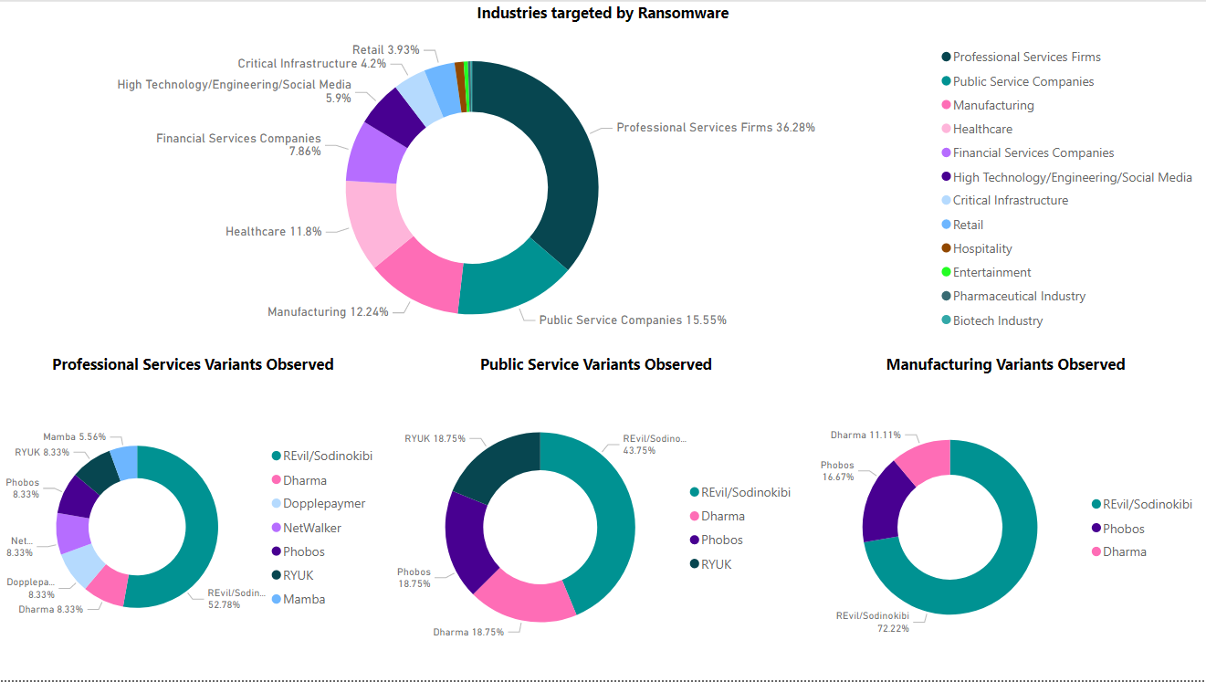
INDUSTRIES & VARIANTS EFFECTED
Notes:
Talking points (Note: Speaker should spend 1 min. MAX talking to each one of the below)
Overview of ransomware response service and why we offer it
Who our customers are
What our ransomware response process is
Any key differentiators from competitors

Slide 10
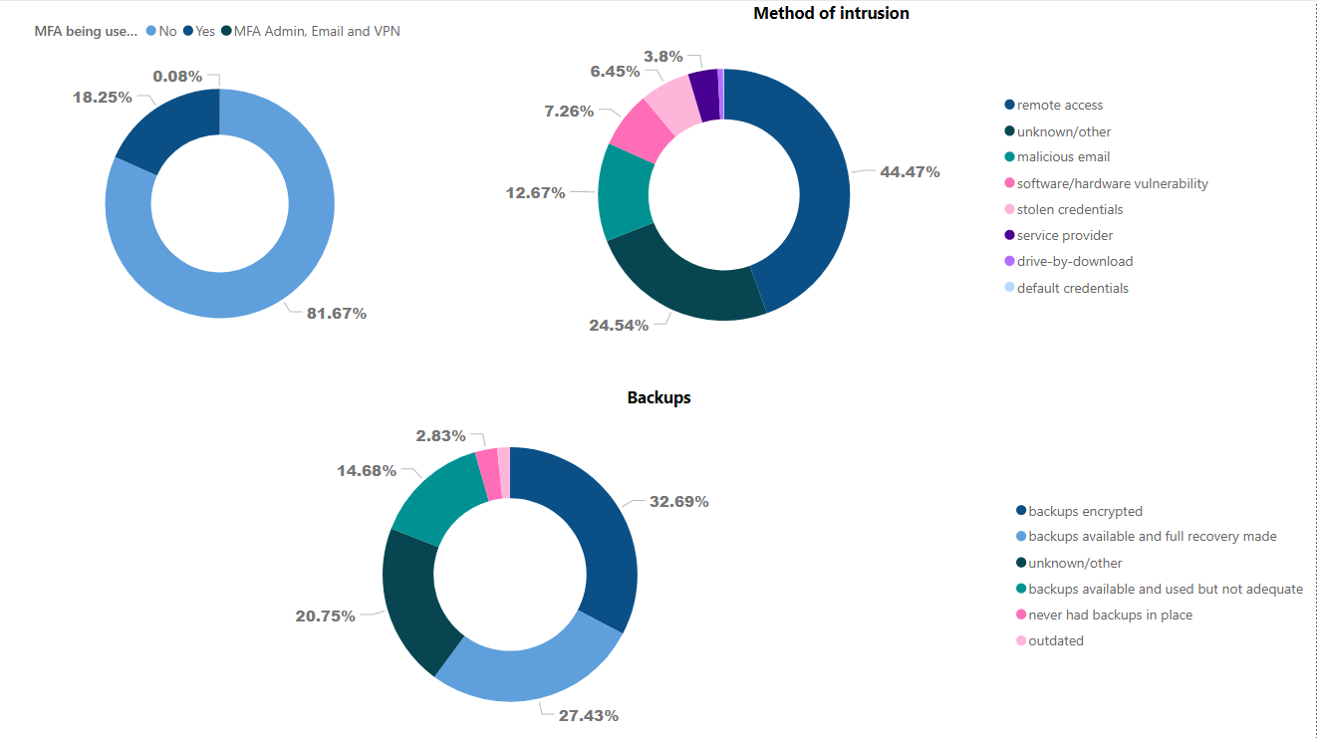
MULTI-FACTOR AUTHENTICATION (MFA), BACKUPS, INTRUSION
Notes:
Talking points (Note: Speaker should spend 1 min. MAX talking to each one of the below)
Overview of ransomware response service and why we offer it
Who our customers are
What our ransomware response process is
Any key differentiators from competitors

Slide 11
CYBER SECURITY BEST PRACTICES
Include best practices for preventing a cyber incident.
Future State Security Program
Compliance / Framework Driven Approach
Bulletproof Backups
Strong Authentication Protocols (2FA/MFA)
Endpoint Detection and Response / Triage Capabilities
Future State Security Program Components
Compliance Drivers / Security Framework Selection
(CIS Critical Security Controls “Top 20” Framework)
Backup Solutions
(Veeam, Veritas, etc.)
Identity Access Mgt. Solutions
(DUO)
Endpoint Detection Response Solution
(SentinelOne)
Continuously Assess & Monitor
Notes:
Talking points (Note: Speaker should spend 1 min. MAX talking to each one of the below)
Overview of business email compromise service
Who our customers are
Notification list process
Key differentiators of service

Slide 12
FUTURE OF THE CYBER MARKET
Cyber Resiliency
Coaching clients on the critical importance of cybersecurity resiliency will remain a core focus.
Attacks will keep morphing to stay ahead of the
“art of the possible”.
Shifting Threat Landscape
Weaponization of Misinformation / Disinformation
Extortion trends will evolve into more sophisticated means such as misinformation/disinformation campaigns to force payments
Deep fakes and advanced social engineering schemes will continue to become more accessible on mainstream marketplaces.
Integration of deep fakes / advanced social engineering
Notes:
Talking points (Note: Speaker should spend 1 min. MAX talking to each one of the below)
Overview of restoration service
Process for restoration services execution
On-site restoration coming soon (What are we doing in the interim?)

Slide 13
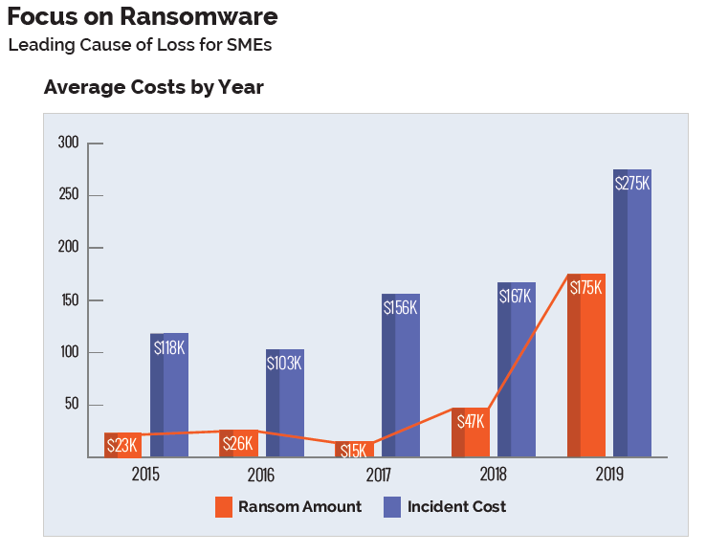
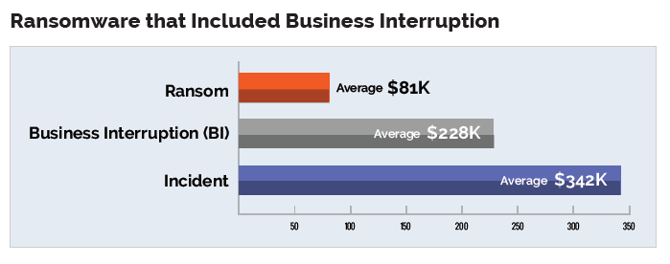
How Did We Get Here?
Source: NetDiligence Cyber Claims Study 2020 Report
1 Average Cost To Recover From Ransomware Skyrockets To Over $84,000 (forbes.com)
2 Florida City Agrees To Astonishing $600,000 Ransom Payout (Updated) (forbes.com)
3 The 2021 State of IT (swzd.com)
4 How to Implement & Assess Your Cyber Hygiene (cisecurity.org)
5 Ponemon Institute’s The Fourth Annual Study on the Cyber Resilient Organization, page 35
6 NetDiligence Cyber Claims Study, 2019 Report

Slide 14
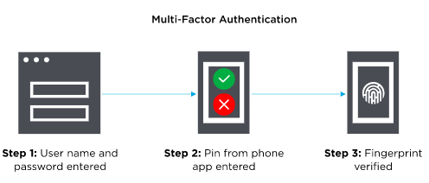
Multi-Factor Authentication (MFA)
Multi-Factor Authentication (MFA) is an authentication method that requires the user to provide two or more verification factors to gain access to a resources such as an application, online account, or a VPN.
Based on three types of additional information:
  Things you know (knowledge), such as a password or PIN
  Things you have (possession), such as a badge or phone
  Things you are (inherence), such as a biometric like fingerprints or voice recognition
Go Back
Source: Onelogin
https://www.onelogin.com/learn/what-is-mfa#:~:text=Most%20MFA%20authentication%20methodology%20is%20based%20on%20one,as%20a%20biometric%20like%20fingerprints%20or%20voice%20recognition
Notes:
NOTE: When in Slide Show mode, click the “Go Back” home button to return to Slide 13.

Slide 15
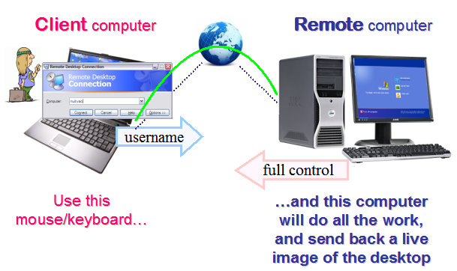
Remote Desktop Protocols (RDP)
A proprietary protocol developed by Microsoft, which provides a user with a graphical interface to connect to another computer over a network connection.
Not all “open” RDP ports are bad. Some are necessary to perform certain business functions. Others have been identified as open doors, used by various hacking groups. Insurers are increasingly scanning for the open “bad” ports, alerting insureds that they need to be closed to reduce the risk of network exploitation/ransomware attacks.
Go Back
Source: www.speedmypcupfree.com
https://www.speedupmypcfree.com/wp-content/uploads/2013/12/remote-desktop-protocol.png
Notes:
NOTE: When in Slide Show mode, click the “Go Back” home button to return to Slide 13.

Slide 16
Advanced Endpoint Protection
Also known as Endpoint Detection and Response (EDR) or Endpoint Threat Detection
EDR is a category of tools and technology used for protecting computer hardware devices–called endpoints – from potential threats. EDR platforms are made from tools that focus on detecting possible malicious endpoint activities, commonly through employing continuous monitoring.
Capabilities of most EDR Solutions:
  The unification of endpoint data.
  Increased visibility throughout a whole IT environment.
  The ability to monitor endpoints, either online or offline.
  The ability to detect malware and store endpoint events.
  The ability to respond to an event in real-time.
  Integration with additional security tools.
  The use of blacklists and whitelists.
Go Back
Source: TechTarget SearchSecurity
https://searchsecurity.techtarget.com/definition/endpoint-detection-and-response-EDR#:~:text=Endpoint%20detection%20and%20response%20(EDR)%20is%20a%20category,malicious%20endpoint%20activities,%20commonly%20through%20employing%20continuous%20monitoring.
Notes:
NOTE: When in Slide Show mode, click the “Go Back” home button to return to Slide 13.

Slide 17
SMBv1
Server Message Block (SMB) is a protocol used primarily for sharing files, printer services, and communication between computers on a network.
SMBv1 was deprecated in 2013 and is no longer installed by default on Windows Server 2016. There are a handful of vulnerabilities that exist within SMBv1, most of which allow for remote code execution on the target host.
More often than not, SMBv1 can be completely disabled. Unless the insured has legacy systems in their environment that require SMBv1 (Windows XP) or legacy applications that rely on it, they will likely not affect anything by disabling it.
The presence of SMBv1 on a network is concerning for underwriters, as it represents an increased vulnerability to attack.
Go Back
Source: Stealthbits
https://stealthbits.com/blog/what-is-smbv1-and-why-you-should-disable-it/
Notes:
NOTE: When in Slide Show mode, click the “Go Back” home button to return to Slide 13.

Slide 18
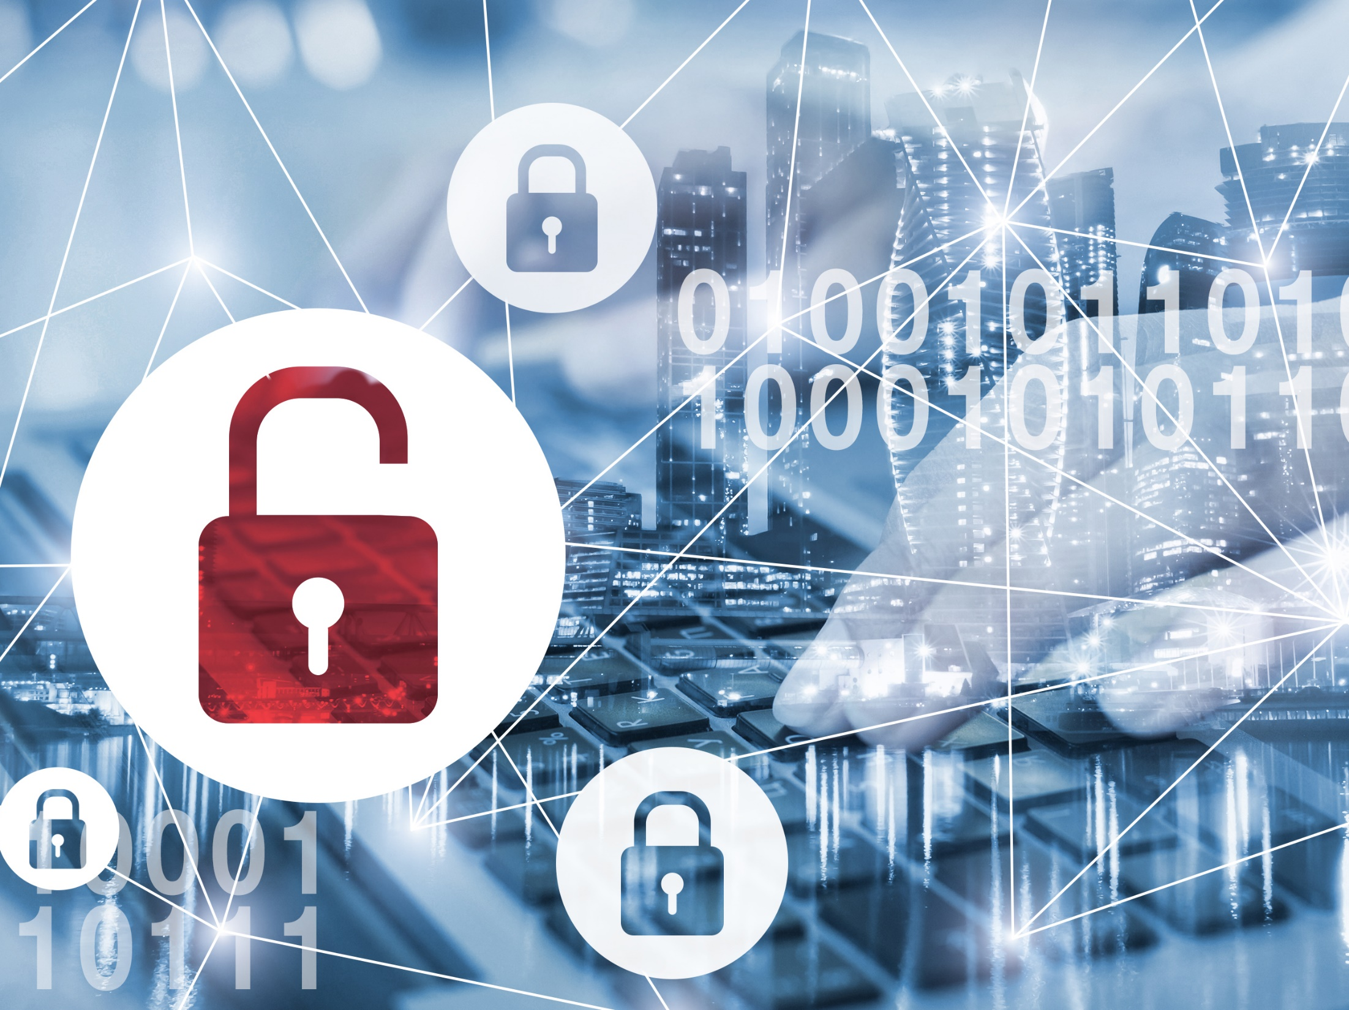
What does it cover?
Navigating this new frontier requires teamwork

Slide 19
Liability Coverages
LIABILITY COVERAGES
Coverage Grant | Claim Scenario | Notes
Privacy Liability (Including Employee Privacy) | The insured mistakenly posts the private information of thousands of its customers online. The information contained financial information, social security numbers and account passwords. A class of affected customers sued the insured for damages suffered resulting from the unauthorized release of their information.
Privacy Regulatory Claims Coverage | A large data breach suffered by the insured drew the attention of State privacy regulators and resulted in defense costs associated with the investigation and a sizeable fine for violation of the State’s privacy laws. | Fines & penalties insured where allowable by law GDPR wording has been added by name to the definition of “Privacy regulations” CCPA and IL BIPA are not mentioned by name, but covered by virtue of policy construction (where allowable by law)
Security Liability | An overseas hacking group gained unauthorized access to the insured’s network and utilized the network as a host, enabling them to disguise their distributed denial of service attacks against other businesses. The insured was unaware of the intrusion and was presented with a lawsuit for damages suffered by the victims due to the insured’s failure to protect the security of their computer system.
Multimedia Liability | Allegations of defamation contained in a blog produced by the insured’s marketing team on their website led to a lawsuit from one of the insured’s competitors. Significant costs were incurred to defend the insured in this matter. | Includes the insured’s social media footprint Includes IP infringement – not patent “Unless such event occurs as a result of a “Security Compromise”.
PCI DSS Assessment | The insured suffers a data breach involving the credit card numbers of thousands of their customers. They incur significant fines and expenses to their bank and card association, and, have to pay a Qualified Security Assessor (QSA) to conduct an audit to prove their compliance with the PCI Data Security Standards. | See expanded definition of “Breach Response Costs”, which includes cost of mandatory audit by a Qualified Security Assessor (QSA) and/or cost of a PCI Forensic Investigator to shadow the PFI following a “Security Breach”.

Slide 20
FIRST PARTY COVERAGES
Coverage Grant | Claim Scenario | Notes
Security Breach Response Coverage | A breach of the insured’s systems allowed the perpetrator access to the protected health information of 20,000 current and past patients. The event led to extensive expenses incurred for legal assistance, the hiring of IT forensic investigators, a PR firm, offering identity restoration services, setting up a call center to respond to inquiries, and notification to all of their affected patients. | No retention for use of Breach Response Counsel Security Breach Response Coverage is now among the 1st Party coverages with no annual aggregate limit - only carries a per event limit
Cyber Extortion | The insured suffers a ransomware attack on their network and is unable to access their servers or their backups. The perpetrator has demanded a ransom the equivalent to $700,000 in bitcoin. The Cyber Extortion insuring agreement pays for the experts to assist and the money to pay the ransom if it is determined that the only means of resolving the situation is to do so. | Ransomware Cryptocurrency payment included
Business Income and Digital Asset Restoration | As a result of the insured’s network being inaccessible due to infiltration of malware, their ecommerce site was also down, causing significant income loss and extra expenses incurred to establish work-around procedures. | System Failure Insured’s System Third Party Systems
Systems Integrity Restoration (aka: “Bricking”) | The insured’s network is infected by a malicious malware attack, causing many of their physical servers (hardware) to be rendered useless after the event. The Systems Integrity Restoration extension on their Business Income and Digital Asset Restoration insuring agreement allowed them to replace the affected hardware up to a sub-limit. Property damage of this nature is typically excluded from Cyber risk policies. | You will not find the word “bricking” in the policy wording. See “Systems Integrity Restoration Loss”. ITEM 3.II.G.4. on dec. page.
Computer System (aka: “Betterment”) | After experiencing a particularly malicious virus on their network, the insured determined that a more secure version of their software platform was required, however, the cost to replace the new system was 15% higher than the cost of their existing system. The “betterment” provision in their policy allowed them to do this, up to 25% more than the cost to replace the original system, subject to a sub-limit. | You will not find the word “betterment” in the policy wording. See amended definition of “Restoration Costs” in the policy See “Computer System” . ITEM 3.III.H. on dec. page. Subject to $250K sublimit

Slide 21
CYBER DECEPTION & ELECTRONIC FRAUD
Coverage Grant | Claim Scenario | Notes
Cyber Deception | CFO receives email from someone purporting to be the company’s CEO, directing transfer of $100,000 to a vendor, with wiring instructions. The email was fraudulent. The CFO doesn’t verify the email’s authenticity and sends the funds - unable to recover the money once discovered that the CEO was being impersonated. | You will not find the words “Social Engineering” in the policy. It is referred to as “Cyber Deception”. Includes funds held on behalf of others No call-back requirement Includes value of goods
Phishing | The insured’s system is hacked and perpetrators, able to familiarize themselves with the company’s billing practices, send out fraudulent invoices to customers, re-directing funds to their own account. Insured is unable to collect the receivable due to them because their clients already “paid their” invoice – just unknowingly to the wrong person. Were it not for the insured’s failure to adequately protect their system, the loss would not have occurred. This is a first-party loss for the insured. | Also known as “Invoice Manipulation” , “Reverse Social Engineering” or “Push Payment Fraud” in other policies Beware of third-party sub-limits offered here by other carriers – should be contemplated under the 3rd party Security liability insuring agreement at full policy limits.
Personal Financial Loss | In the course of gaining unauthorized access to the insured’s computer network, perpetrators gain access to the senior executive officer’s personal bank account and steal funds. | Senior executive officer is un-defined term.
Corporate ID Theft | An unauthorized third party uses the electronic identity of an insured to establish credit in the insured’s name and is able to steal money as a result of this impersonation.
Telephone Hacking | The insured notices excessive long distance charges on their account and discovers their system has been hacked and the perpetrators are utilizing the system to make unauthorized long distance calls. | Was previously offered via endorsement – now automatic
Funds Transfer Fraud | An unauthorized third party gains access to the insured’s computer system and electronically impersonates the insured, instructing the insured’s bank to transfer funds to their fraudulent account. | Not to be confused with Cyber Deception Was previously offered via endorsement – now automatic

Slide 22
Q1 2021: How Can Insured’s Prepare For Their Cyber Insurance Renewal?
Having these efforts in place will make insureds more desirable to the insurance marketplace
Have a plan for managing information risk that includes ransomware recovery
Implementation of Multi-Factor Authentication (MFA)
Properly configure Remote Desktop Protocols (RDP)
Deployment of advanced endpoint protection or EDR
Ongoing employee training in InfoSec best practices
Phishing simulation campaigns
Software patch management
3-2-1 data back-up strategy
  3 copies; 2 local, but on different mediums; 1 off-site
  Segregated from the primary network
  Encrypted and tested regularly
Notes:
NOTE: When in Slide Show mode, click on a green question-mark box to see definition of each term. On the definition page, click “Go Back” home button to return to this page.

Slide 23
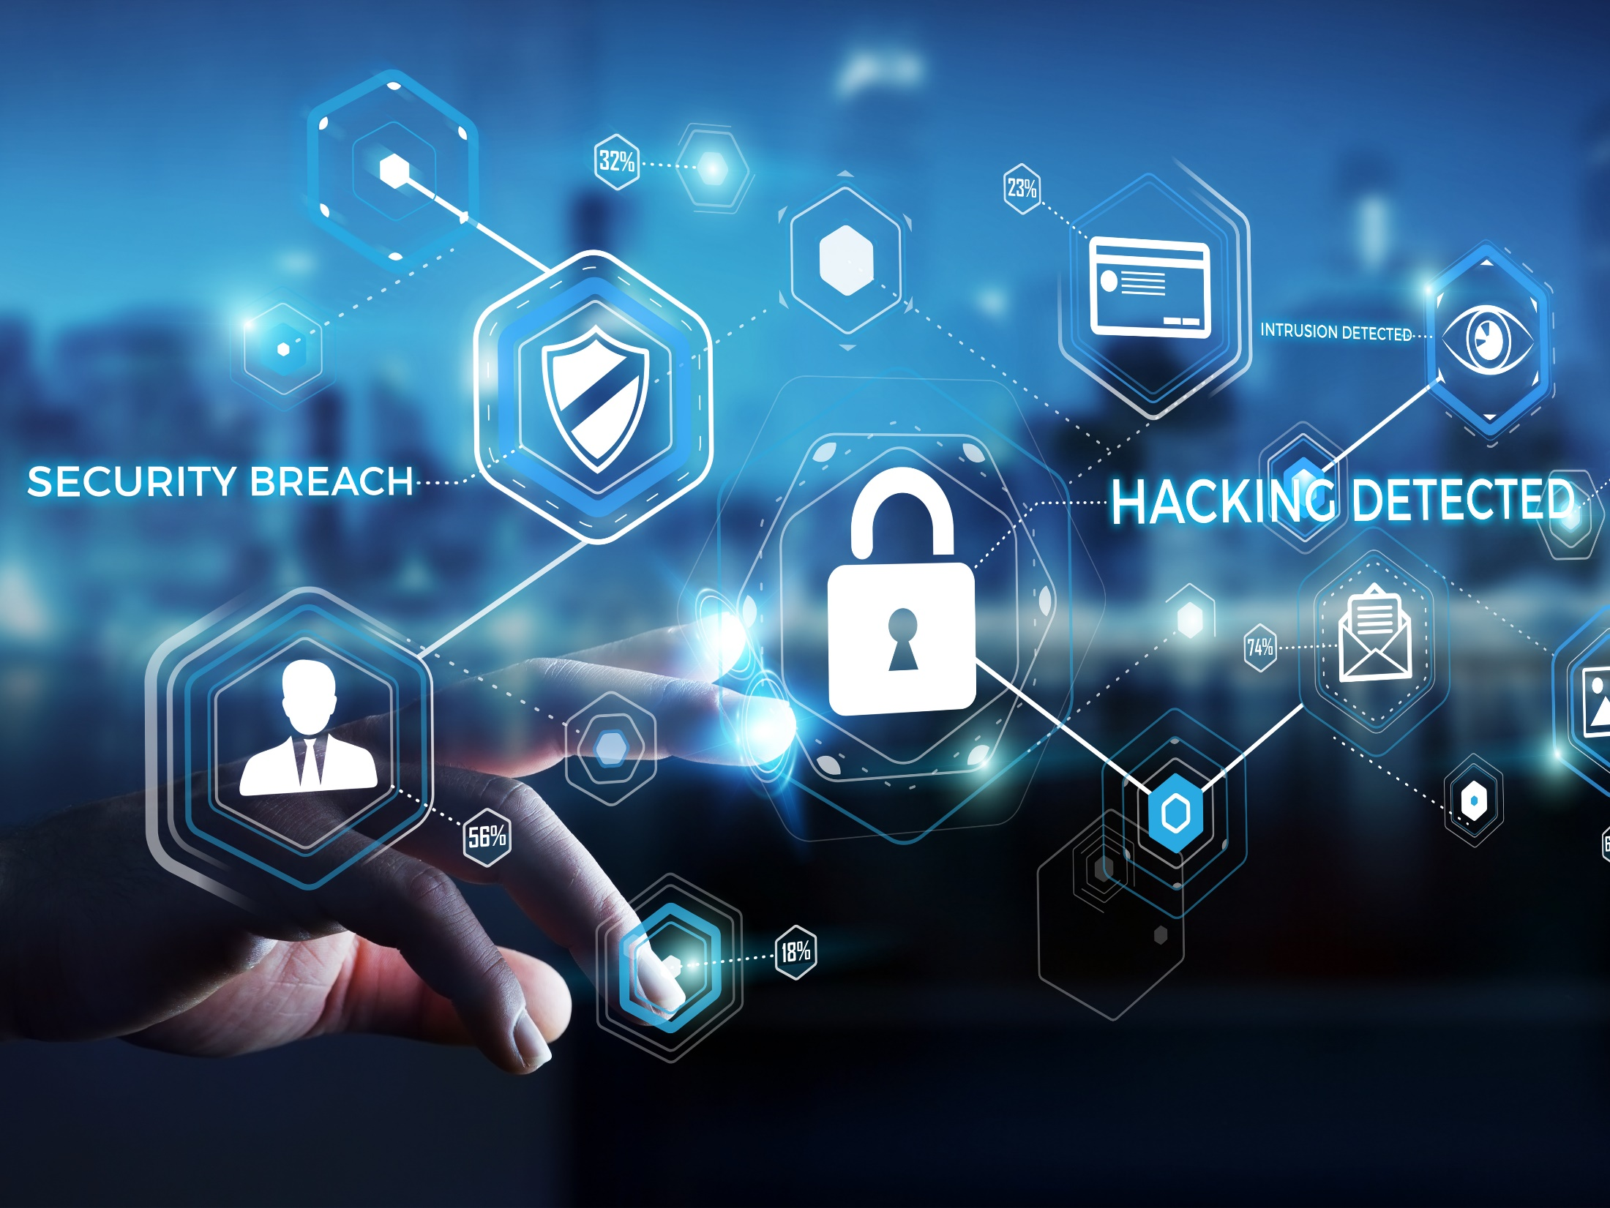
Thank you!
Adam Connor
Paul Caron
The information contained herein is offered as insurance industry guidance and provided as an overview of current market risks and available coverages and is intended for discussion purposes only. This publication is not intended to offer legal advice or client-specific risk management advice. Any description of insurance coverages is not meant to interpret specific coverages that a company may already have in place or that may be generally available. General insurance descriptions contained herein do not include complete insurance policy definitions, terms, and/or conditions, and should not be relied on for coverage interpretation. Actual insurance policies must always be consulted for full coverage details and analysis.
© 2021 Risk Placement Services, Inc.

