Slide 1



Faulty Workmanship Coverage:
A new insurance solution for contractors who self-perform their work

Slide 2
Introduction
Jessica Enochs, American Subcontractors Association
Joe Reynolds, RT Specialty ECP
Faulty Workmanship 101

Slide 3



Faulty Work
What’s out there now?
What is it?
How it works.
Who’s it for?
Faulty Work Solutions
Claims Examples

Slide 4

Faulty Workmanship- Before we begin…
  Commercial General Liability (CGL) and Contractors Professional Liability (CPRL) Policies typically exclude Cost to Replace or Repair Faulty Work
  CGL- covers resulting BI/PD of subcontractors’ faulty work
    No coverage for repair and replace or economic damages.
  CPRL- covers Negligent A/E/O in Professional Services and if certain coverage conditions are in place,
  faulty work arising out of negligent A/E/O.

Slide 5
Faulty Workmanship: How it works
Offered as a separate product, independent insuring agreement, or by endorsement.
Claims made coverage trigger
Provides coverage for:
Claims arising out of the workmanship of Your Work or in the use of defective materials or products in Your Work

Slide 6
Faulty Workmanship: Key Definitions
Your Work means:
work or operations performed by you; and
materials, parts or equipment furnished in connection with such work or operations
Includes:
warranties or representations made at any time with respect to the fitness, quality, durability, performance or use of Your Work, and
the providing of, or failure to provide warnings or instructions
Your Installed Product Means:
any goods or products, other than real property, installed by you; and
containers (other than vehicles), materials, parts or equipment furnished in connection with such goods or products
Includes:
warranties or representations made at any time with respect to the fitness, quality, durability, performance or use of Your Installed Product; and
the providing of or failure to provide warnings or instructions

Slide 7
Faulty Workmanship: Notable Exclusions:
Bodily Injury: Generally covered under the GL
Substitutions: “I don’t’ like this color color on this wall”
Professional Services- Covered under the Professional Insuring Agreement
Project Delays and CDs - some apply to entire policy; others apply just to the Faulty Work insuring agreement

Slide 8
Faulty Workmanship: Who’s a fit?
Artisan, Trade Contractors, and GCs who self-perform work
Self-performing work
Examples: Electricians, flooring, plumbers, HVAC/mechanical,
carpenters, masons, utility contractors, etc.
Pro Tip: When contractors start subbing out work or performing or delegating design the emphasis on exposure shifts to Contractors Professional Liability – For another presentation!

Slide 9
Faulty Workmanship Product Configurations …
Product Type | Blended Professional, Contractors Pollution, and Faulty Workmanship Claims-Made form
Coverage Desc. | For faulty work and defective products
Capacity | $1,000,000 - $5,000,000 per claim/aggregate (can also be a sublimit)
Appetite | Artisan/subs and GCs who self-perform only Insurer Caution or No-go Classes: EIFS, Roofers, residential exposures (selective), structural, environmental contractors.
Cost | Starts at $1,200-3,500 and goes up based upon project types and size of the contractor.

Slide 10
Claims Examples
Flatwork
Concrete Coatings
Electrical Project
Drywall Work
Sewer Work
Flooring
Plumbing

Slide 11

Concrete Coatings and Delamination

Slide 12
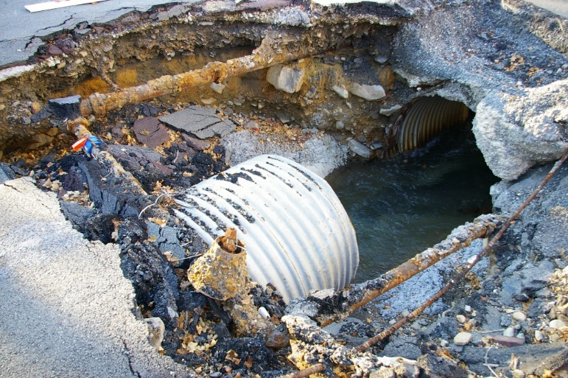

Sewer Work

Slide 13

Masonry

Slide 14

Pipefitting Pressure Fail

Slide 15

We can keep going… questions?

Slide 16

Questions? Thank You!
Joseph Reynolds, JD, CRIS
Assistant Vice President,
RT Specialty Environmental and Construction Professional
Joseph.reynolds@rtspecialty.com
C) 484-787-7078
RT ECP is a division of R-T Specialty, LLC. R-T Specialty, LLC (RT), a subsidiary of Ryan Specialty Group, LLC, provides wholesale brokerage and other services to agents and brokers. RT is a Delaware limited liability company based in Illinois. As a wholesale broker, RT does not solicit insurance from the public. Some products may only be available in certain states, and some products may only be available from surplus lines insurers. In California: R-T Specialty Insurance Services, LLC License #0G97516. © 2020 Ryan Specialty Group, LLC

